Slide 1


Slide 2
Chapter 11
Friends, Overloaded Operators,
and Arrays in Classes

Slide 3
Overview
11.1 Friend Functions
11.2 Overloading Operators
11.3 Arrays and Classes
11.4 Classes and Dynamic Arrays
Slide 11- <number>

Slide 4
11.1
Friend Functions

Slide 5
Friend Function
Class operations are typically implemented
as member functions
Some operations are better implemented as
ordinary (nonmember) functions
Slide 11- <number>

Slide 6
Program Example:
An Equality Function
The DayOfYear class from Chapter 10 can
be enhanced to include an equality function
  An equality function tests two objects of
  type DayOfYear to see if their values represent
  the same date
  Two dates are equal if they represent the same
  day and month
Slide 11- <number>

Slide 7
Declaration of
The equality Function
We want the equality function to return a value
of type bool that is true if the dates are the same
The equality function requires a parameter for
each of the two dates to compare
The declaration is
bool equal(DayOfYear date1, DayOfYear date2);
  Notice that equal is not a member of the class DayOfYear
Slide 11- <number>

Slide 8
Defining Function equal
The function equal, is not a member function
  It must use public accessor functions to obtain the
  day and month from a DayOfYear object
equal can be defined in this way:
bool equal(DayOfYear date1, DayOfYear date2)
{
return ( date1.get_month( ) == date2.get_month( )
&&
date1.get_day( ) == date2.get_day( ) );
}
Slide 11- <number>

Slide 9
Using The Function equal
The equal function can be used to compare dates
in this manner
if ( equal( today, bach_birthday) )
cout << "It's Bach's birthday!";
A complete program using function equal is
found in
Display 11.1 (1)
Display 11.1 (2)
Display 11.1 (3)
Slide 11- <number>

Slide 10
Is equal Efficient?
Function equal could be made more efficient
  Equal uses member function calls to obtain the
  private data values
  Direct access of the member variables would be more efficient (faster)
Slide 11- <number>

Slide 11
A More Efficient equal
As defined here, equal is more efficient,
but not legal
bool equal(DayOfYear date1, DayOfYear date2)
{
return (date1.month = = date2.month
&&
date1.day = = date2.day );
}
  The code is simpler and more efficient
  Direct access of private member variables is not legal!
Slide 11- <number>

Slide 12
Friend Functions
Friend functions are not members of a class, but
can access private member variables of the class
  A friend function is declared using the keyword
  friend in the class definition
    A friend function is not a member function
    A friend function is an ordinary function
    A friend function has extraordinary access to data members of the class
  As a friend function, the more efficient version of equal is legal
Slide 11- <number>

Slide 13
Declaring A Friend
The function equal is declared a friend in the
abbreviated class definition here
class DayOfYear
{
public:
friend bool equal(DayOfYear date1,
DayOfYear date2);
// The rest of the public members
private:
// the private members
};
Slide 11- <number>

Slide 14
Using A Friend Function
A friend function is declared as a friend in the
class definition
A friend function is defined as a nonmember
function without using the "::" operator
A friend function is called without using the
'.' operator
Display 11.2
Slide 11- <number>

Slide 15
Friend Declaration Syntax
The syntax for declaring friend function is
class class_name
{
public:
friend Declaration_for_Friend_Function_1
friend Declaration_for_Friend_Function_2
…
Member_Function_Declarations
private:
Private_Member_Declarations
};
Slide 11- <number>

Slide 16
Are Friends Needed?
Friend functions can be written as non-friend
functions using the normal accessor and mutator
functions that should be part of the class
The code of a friend function is simpler and it is
more efficient
Slide 11- <number>

Slide 17
Choosing Friends
How do you know when a function should be
a friend or a member function?
  In general, use a member function if the task
  performed by the function involves only one object
  In general, use a nonmember function if the task
  performed by the function involves more than
  one object
    Choosing to make the nonmember function a friend is
    a decision of efficiency and personal taste
Slide 11- <number>

Slide 18
Program Example:
The Money Class (version 1)
Display 11.3 demonstrates a class called Money
  U.S. currency is represented
  Value is implemented as an integer representing the value as if converted to pennies
    An integer allows exact representation of the value
    Type long is used to allow larger values
  Two friend functions, equal and add, are used
Display 11.3 (1 – 5)
Slide 11- <number>

Slide 19
Characters to Integers
Notice how function input (Display 11.3)
processes the dollar values entered
  First read the character that is a $ or a –
    If it is the -, set the value of negative to true and read the
    $ sign which should be next
  Next read the dollar amount as a long
  Next read the decimal point and cents as three
  characters
    digit_to_int is then used to convert the cents characters to
    integers
Slide 11- <number>

Slide 20
digit_to_int (optional)
digit_to_int is defined as
int digit_to_int(char c)
{
return ( int ( c ) – int ( '0') );
}
  A digit, such as '3' is parameter c
    This is the character '3' not the number 3
  The type cast int(c) returns the number that implements the character stored in c
  The type cast int('0') returns the number that implements the character '0'
Slide 11- <number>

Slide 21
int( c) – int ('0')?
The numbers implementing the digits are in
in order
  int('0') + 1 is equivalent to int('1')
  int('1') + 1 is equivalent to int('2')
If c is '0'
  int( c ) - int('0') returns integer 0
If c is '1'
  int( c ) – int ('0') returns integer 1
Slide 11- <number>

Slide 22
Leading Zeros
Some compilers interpret a number with a
leading zero as a base 8 number
  Base 8 uses digits 0 – 7
Using 09 to represent 9 cents could cause an error
  the digit 9 is not allowed in a base 8 number
The ANSI C++ standard is that input should be interpreted as base 10 regardless of a leading zero
Slide 11- <number>

Slide 23
Parameter Passing Efficiency
A call-by-value parameter less efficient than a
call-by-reference parameter
  The parameter is a local variable initialized to the
  value of the argument
    This results in two copies of the argument
A call-by-reference parameter is more efficient
  The parameter is a placeholder replaced by the
  argument
    There is only one copy of the argument
Slide 11- <number>

Slide 24
Class Parameters
It can be much more efficient to use
call-by-reference parameters when the parameter
is of a class type
When using a call-by-reference parameter
  If the function does not change the value of the
  parameter, mark the parameter so the compiler
  knows it should not be changed
Slide 11- <number>

Slide 25
const Parameter Modifier
To mark a call-by-reference parameter so it
cannot be changed:
  Use the modifier const before the parameter type
  The parameter becomes a constant parameter
  const used in the function declaration and definition
Slide 11- <number>

Slide 26
const Parameter Example
Example (from the Money class of Display 11.3):
  A function declaration with constant parameters
    friend Money add(const Money& amount1,
    const Money& amount2);
  A function definition with constant parameters
    Money add(const Money& amount1,
    const Money& amount2)
    {
    …
    }
Slide 11- <number>

Slide 27
const Considerations
When a function has a constant parameter,
the compiler will make certain the parameter
cannot be changed by the function
  What if the parameter calls a member function?
  Money add(const Money& amount1,
  const Money& amount2)
  { …
  amount1.input( cin );
  }
  The call to input will change the value of amount1!
Slide 11- <number>

Slide 28
const
And Accessor Functions
Will the compiler accept an accessor function
call from the constant parameter?
Money add(const Money& amount1,
const Money& amount2)
{ …
amount1.output(cout);
}
  The compiler will not accept this code
    There is no guarantee that output will not change the
    value of the parameter
Slide 11- <number>

Slide 29
const Modifies Functions
If a constant parameter makes a member function
call…
  The member function called must be marked so
  the compiler knows it will not change the parameter
  const is used to mark functions that will not change
  the value of an object
  const is used in the function declaration and the
  function definition
Slide 11- <number>

Slide 30
Function Declarations
With const
To declare a function that will not change the
value of any member variables:
  Use const after the parameter list and
  just before the semicolon
  class Money
  {
  public:
  …
  void output (ostream& outs) const ;
  …
Slide 11- <number>

Slide 31
Function Definitions
With const
To define a function that will not change the
value of any member variables:
  Use const in the same location as the function
  declaration
  void Money::output(ostream& outs) const
  {
  // output statements
  }
Slide 11- <number>

Slide 32
const Problem Solved
Now that output is declared and defined using
the const modifier, the compiler will accept
this code
Money add(const Money& amount1,
const Money& amount2)
{ …
amount1.output(cout);
}
Slide 11- <number>

Slide 33
const Wrapup
Using const to modify parameters of class types
improves program efficiency
  const is typed in front of the parameter's type
Member functions called by constant parameters
must also use const to let the compiler know
they do not change the value of the parameter
  const is typed following the parameter list in the
  declaration and definition
Display 11.4
Slide 11- <number>

Slide 34
Use const Consistently
Once a parameter is modified by using const to
make it a constant parameter
  Any member functions that are called by the
  parameter must also be modified using const to
  tell the compiler they will not change the parameter
  It is a good idea to modify, with const, every
  member function that does not change a member
  variable
Slide 11- <number>

Slide 35
Section 11.1 Conclusion
Can you
  Describe the promise that you make to the
  compiler when you modify a parameter with const?
  Explain why this declaration is probably not
  correct?
  class Money
  { …
  public:
  void input(istream& ins) const;
  …
  };
Slide 11- <number>

Slide 36
11.2
Overloading Operators

Slide 37
Overloading Operators
In the Money class, function add was used to
add two objects of type Money
In this section we see how to use the '+' operator
to make this code legal:
Money total, cost, tax;
…
total = cost + tax;
// instead of total = add(cost, tax);
Slide 11- <number>

Slide 38
Operators As Functions
An operator is a function used differently than
an ordinary function
  An ordinary function call enclosed its arguments in
  parenthesis
  add(cost, tax)
  With a binary operator, the arguments are on either
  side of the operator
  cost + tax
Slide 11- <number>

Slide 39
Operator Overloading
Operators can be overloaded
The definition of operator + for the Money
class is nearly the same as member function add
To overload the + operator for the Money class
  Use the name + in place of the name add
  Use keyword operator in front of the +
  Example:
  friend Money operator + (const Money& amount1…
Slide 11- <number>

Slide 40
Operator Overloading Rules
At least one argument of an overloaded operator
must be of a class type
An overloaded operator can be a friend of a class
New operators cannot be created
The number of arguments for an operator cannot
be changed
The precedence of an operator cannot be changed
., ::, *, and ? cannot be overloaded
Slide 11- <number>

Slide 41
Program Example:
Overloading Operators
The Money class with overloaded operators
+ and == is demonstrated in
Display 11.5 (1)
Display 11.5 (2)
Slide 11- <number>

Slide 42
Automatic Type Conversion
With the right constructors, the system can do
type conversions for your classes
  This code (from Display 11.5) actually works
  Money base_amount(100, 60), full_amount;
  full_amount = base_amount + 25;
  The integer 25 is converted to type Money so it
  can be added to base_amount!
  How does that happen?
Slide 11- <number>

Slide 43
Type Conversion Event 1
When the compiler sees base_amount + 25,
it first looks for an overloaded + operator to
perform
Money_object + integer
  If it exists, it might look like this
  friend Money operator +(const Money& amount1,
  const int& amount2);
Slide 11- <number>

Slide 44
Type Conversion Event 2
When the appropriate version of + is not found,
the compiler looks for a constructor that takes
a single integer
  The Money constructor that takes a single parameter
  of type long will work
  The constructor Money(long dollars) converts 25
  to a Money object so the two values can be added!
Slide 11- <number>

Slide 45
Type Conversion Again
Although the compiler was able to find a
way to add
base_amount + 25
this addition will cause an error
base_amount + 25.67
  There is no constructor in the Money class that takes a single argument of type double
Slide 11- <number>

Slide 46
A Constructor For double
To permit base_amount + 25.67, the following
constructor should be declared and defined
class Money
{
public:
…
Money(double amount);
// Initialize object so its value is $amount
…
Slide 11- <number>

Slide 47
Overloading Unary Operators
Unary operators take a single argument
The unary – operator is used to negate a value
x = -y
++ and - - are also unary operators
Unary operators can be overloaded
  The Money class of Display 11.6 can includes
    A binary – operator
    A unary – operator
Slide 11- <number>

Slide 48
Overloading -
Overloading the – operator with two parameters
allows us to subtract Money objects as in
Money amount1, amount2, amount2;
…
amount3 = amount1 – amount2;
Overloading the – operator with one parameter
allows us to negate a money value like this
amount3 = -amount1;
Display 11.6
Slide 11- <number>

Slide 49
Overloading << and >>
The insertion operator << is a binary operator
  The first operand is the output stream
  The second operand is the value following <<
  cout << "Hello out there.\n";
Operand 1
Operand 2
Operator
Slide 11- <number>

Slide 50
Replacing Function output
Overloading the << operator allows us to
use << instead of Money's output function
  Given the declaration: Money amount(100);
  amount.output( cout );
  can become
  cout << amount;
Slide 11- <number>

Slide 51
What Does << Return?
Because << is a binary operator
cout << "I have " << amount << " in my purse.";
seems as if it could be grouped as
( (cout << "I have" ) << amount) << "in my purse.";
To provide cout as an argument for << amount,
(cout << "I have") must return cout
Display 11.7
Slide 11- <number>

Slide 52
Overloaded << Declaration
Based on the previous example, << should return
its first argument, the output stream
  This leads to a declaration of the overloaded
  << operator for the Money class:
  class Money
  {
  public:
  …
  friend ostream& operator << (ostream& outs,
  const Money& amount);
  …
Slide 11- <number>

Slide 53
Overloaded << Definition
The following defines the << operator
  ostream& operator <<(ostream& outs,
  const Money& amount)
  {
  <Same as the body of Money::output in
  Display 11.3 (except all_cents is replaced
  with amount.all_cents) >
  return outs;
  }
Slide 11- <number>

Slide 54
Return ostream& ?
The & means a reference is returned
  So far all our functions have returned values
The value of a stream object is not so simple to
return
  The value of a stream might be an entire file, the
  keyboard, or the screen!
We want to return the stream itself, not the
value of the stream
The & means that we want to return the stream,
not its value
Slide 11- <number>

Slide 55
Overloading >>
Overloading the >> operator for input is very
similar to overloading the << for output
  >> could be defined this way for the Money class
  istream& operator >>(istream& ins,
  Money& amount);
  {
  <This part is the same as the body of
  Money::input in Display 11.3 (except that
  all_cents is replaced with amount.all_cents)>
  return ins;
  }
Display 11.8 (1-4)
Slide 11- <number>

Slide 56
Section 11.2 Conclusion
Can you
  Describe the purpose of a making a function a friend?
  Describe the use of constant parameters?
  Identify the return type of the overloaded operators
  << and >>?
Slide 11- <number>

Slide 57
11.3
Arrays and Classes

Slide 58
Arrays and Classes
Arrays can use structures or classes as their
base types
  Example: struct WindInfo
  {
  double velocity;
  char direction;
  }
  WindInfo data_point[10];
Slide 11- <number>

Slide 59
Accessing Members
When an array's base type is a structure or a
class…
  Use the dot operator to access the members of anindexed variable
  Example: for (i = 0; i < 10; i++)
  {
  cout << "Enter velocity: ";
  cin >> data_point[i].velocity;
  …
  }
Slide 11- <number>

Slide 60
An Array of Money
The Money class of Chapter 11 can be the base
type for an array
When an array of classes is declared
  The default constructor is called to initialize the
  indexed variables
An array of class Money is demonstrated in
Display 11.9 (1-3)
Slide 11- <number>

Slide 61
Arrays as Structure Members
A structure can contain an array as a member
  Example: struct Data
  {
  double time[10];
  int distance;
  }
  Data my_best;
  my_best contains an array of type double
Slide 11- <number>

Slide 62
Accessing Array Elements
To access the array elements within a structure
  Use the dot operator to identify the array within the structure
  Use the [ ]'s to identify the indexed variable desired
  Example: my_best.time[i]
  references the ith indexed variable of the variable time in the structure my_best
Slide 11- <number>

Slide 63
Arrays as Class Members
Class TemperatureList includes an array
  The array, named list, contains temperatures
  Member variable size is the number of items stored
  class TemperatureList
  {
  public:
  TemperatureList( );
  //Member functions
  private:
  double list [MAX_LIST_SIZE];
  int size;
  }
Slide 11- <number>

Slide 64
Overview of TemperatureList
To create an object of type TemperatureList:
  TemperatureList my_data;
To add a temperature to the list:
  My_data.add_temperature(77);
    A check is made to see if the array is full
<< is overloaded so output of the list is
  cout << my_data;
Display 11.10 (1-2)
Slide 11- <number>

Slide 65
Section 11.3 Conclusion
Can you
  Declare an array as a member of a class?
  Declare an array of objects of a class?
  Write code to call a member function of an element in an array of objects of a class?
  Write code to access an element of an array of
  integers that is a member of a class?
Slide 11- <number>

Slide 66
11.4
Classes and Dynamic Arrays

Slide 67
Classes and Dynamic Arrays
A dynamic array can have a class as its base type
A class can have a member variable that is a
dynamic array
  In this section you will see a class using a dynamic array as a member variable.
Slide 11- <number>

Slide 68
Program Example:
A String Variable Class
We will define the class StringVar
  StringVar objects will be string variables
  StringVar objects use dynamic arrays whose size is determined when the program is running
  The StringVar class is similar to the string class
  discussed earlier
Slide 11- <number>

Slide 69
The StringVar Constructors
The default StringVar constructor creates an
object with a maximum string length of 100
Another StringVar constructor takes an argument
of type int which determines the maximum
string length of the object
A third StringVar constructor takes a C-string
argument and…
  sets maximum length to the length of the C-string
  copies the C-string into the object's string value
Slide 11- <number>

Slide 70
The StringVar Interface
In addition to constructors, the StringVar
interface includes:
  Member functions
    int length( );
    void input_line(istream& ins);
    friend ostream& operator << (ostream& outs,
    const StringVar& the_string);
  Copy Constructor …discussed later
  Destructor …discussed later
Display 11.11 (1)
Display 11.11 (2)
Slide 11- <number>

Slide 71
A StringVar Sample Program
Using the StringVar interface of Display 11.11,
we can write a program using the StringVar class
  The program uses function conversation to
    Create two StringVar objects, your_name and our_name
    your_name can contain any string max_name_size or shorter in length
    our_name is initialized to "Borg" and can have any string of 4 or less characters
Display 11.11 (3)
Slide 11- <number>

Slide 72
The StringVar Implementation
StringVar uses a dynamic array to store its string
  StringVar constructors call new to create the dynamic array for member variable value
  '\0' is used to terminate the string
  The size of the array is not determined until the
  array is declared
    Constructor arguments determine the size
Display 11.12 (1)
Display 11.12 (2)
Slide 11- <number>

Slide 73
Dynamic Variables
Dynamic variables do not "go away" unless
delete is called
  Even if a local pointer variable goes away at the end of a function, the dynamic variable it pointed to remains unless delete is called
  A user of the SringVar class could not know that a dynamic array is a member of the class, so could not be expected to call delete when finished with a StringVar object
Slide 11- <number>

Slide 74
Destructors
A destructor is a member function that is called
automatically when an object of the class goes
out of scope
  The destructor contains code to delete all dynamic variables created by the object
  A class has only one destructor with no arguments
  The name of the destructor is distinguished from the default constructor by the tilde symbol ~
    Example: ~StringVar( );
Slide 11- <number>

Slide 75
~StringVar
The destructor in the StringVar class must call
delete [ ] to return the memory of any dynamic
variables to the freestore
  Example: StringVar::~StringVar( )
  {
  delete [ ] value;
  }
Slide 11- <number>

Slide 76
Pointers as
Call-by-Value Parameters
Using pointers as call-by-value parameters yields
results you might not expect
  Remember that parameters are local variables
    No change to the parameter should cause a change to the argument
  The value of the parameter is set to the value of the argument (an address is stored in a pointer variable)
    The argument and the parameter hold the same address
  If the parameter is used to change the value pointed to, this is the same value pointed to by the argument!
Display 11.13
Display 11.14
Slide 11- <number>

Slide 77
Copy Constructors
The problem with using call-by-value parameters
with pointer variables is solved by the
copy constructor.
A copy constructor is a constructor with one
parameter of the same type as the class
  The parameter is a call-by-reference parameter
  The parameter is usually a constant parameter
  The constructor creates a complete, independent copy of its argument
Slide 11- <number>

Slide 78
StringVar Copy Constructor
This code for the StringVar copy constructor
  Creates a new dynamic array for a copy of the
  argument
    Making a new copy, protects the original from changes
  StringVar::StringVar(const StringVar& string_object)
  : max_length(string_object.length())
  {
  value = new char[max_length+ 1];
  strcpy(value, string_object.value);
  }
Slide 11- <number>

Slide 79
Calling a Copy Constructor
A copy constructor can be called as any other
constructor when declaring an object
The copy constructor is called automatically
  When a class object is defined and initialized by an object of the same class
  When a function returns a value of the class type
  When an argument of the class type is plugged in for a call-by-value parameter
Slide 11- <number>

Slide 80
The Need For a Copy Constructor
This code (assuming no copy constructor)
illustrates the need for a copy constructor
  void show_string(StringVar the_string)
  { …}
  StringVar greeting("Hello");
  show_string(greeting);
  cout << greeting << endl;
  When function show_string is called, greeting is copied into the_string
    the_string.value is set equal to greeting.value
Slide 11- <number>

Slide 81
The Need For a Copy Constructor (cont.)
Since greeting.value and the_string.value are
pointers, they now point to the same dynamic
array
"Hello"
greeting.value
the_string.value
Slide 11- <number>

Slide 82
The Need For a Copy Constructor (cont.)
When show_string ends, the destructor for
the_string executes, returning the dynamic array
pointed to by the_string.value to the freestore
greeting.value now points to memory that has
been given back to the freestore!
Undefined
greeting.value
the_string.value
Slide 11- <number>

Slide 83
The Need For a Copy Constructor (cont.)
Two problems now exist for object greeting
  Attempting to output greeting.value is likely to
  produce an error
    In some instances all could go OK
  When greeting goes out of scope, its destructor will be called
    Calling a destructor for the same location twice is likely to produce a system crashing error
Slide 11- <number>

Slide 84
Copy Constructor Demonstration
Using the same example, but with a copy
constructor defined
  greeting.value and the_string.value point to
  different locations in memory
"Hello"
"Hello"
greeting.value
the_string.value
Slide 11- <number>

Slide 85
Copy Constructor Demonstration (cont.)
When the_string goes out of scope, the destructor is called, returning the_string.value to the freestore
  greeting.value still exists and can be accessed or deleted without problems
"Hello"
undefined
greeting.value
the_string.value
Slide 11- <number>

Slide 86
When To Include a
Copy Constructor
When a class definition involves pointers and
dynamically allocated memory using "new",
include a copy constructor
Classes that do not involve pointers and
dynamically allocated memory do not need
copy constructors
Slide 11- <number>

Slide 87
The Big Three
The big three include
  The copy constructor
  The assignment operator
  The destructor
If you need to define one, you need to define all
Slide 11- <number>

Slide 88
The Assignment Operator
Given these declarations:
StringVar string(10), string2(20);
the statement
string1 = string2;
is legal
But, since StringVar's member value is a
pointer, we have string1.value and string2.value
pointing to the same memory location
Slide 11- <number>

Slide 89
Overloading =
The solution is to overload the assignment
operator = so it works for StringVar
  operator = is overloaded as a member function
  Example: operator = declaration
  void operator=(const StringVar& right_side);
    Right_side is the argument from the right side of the = operator
Slide 11- <number>

Slide 90
Definition of =
The definition of = for StringVar could be:
void StringVar::operator= (const StringVar& right_side)
{
int new_length = strlen(right_side.value);
if (( new_length) > max_length)
new_length = max_length;
for(int i = 0; i < new_length; i++)
value[i] = right_side.value[i];
value[new_length] = '\0';
}
Slide 11- <number>

Slide 91
= Details
This version of = for StringVar
  Compares the lengths of the two StringVar's
  Uses only as many characters as fit in the
  left hand StringVar object
  Makes an independent copy of the right hand object in the left hand object
Slide 11- <number>

Slide 92
Problems with =
The definition of operator = has a problem
  Usually we want a copy of the right hand argument regardless of its size
  To do this, we need to delete the dynamic array in the left hand argument and allocate a new array large enough for the right hand side's dynamic array
  The next slide shows this (buggy) attempt at
  overloading the assignment operator
Slide 11- <number>

Slide 93
Another Attempt at =
void StringVar::operator= (const StringVar& right_side)
{
delete [ ] value;
int new_length = strlen(right_side.value);
max_length = new_length;
value = new char[max_length + 1];
for(int i = 0; i < new_length; i++)
value[i] = right_side.value[i];
value[new_length] = '\0';
}
Slide 11- <number>

Slide 94
A New Problem With =
The new definition of operator = has a problem
  What happens if we happen to have the same object on each side of the assignment operator?
  my_string = my_string;
  This version of operator = first deletes the dynamic array in the left hand argument.
  Since the objects are the same object, there is no longer an array to copy from the right hand side!
Slide 11- <number>

Slide 95
A Better = Operator
void StringVar::operator = (const StringVar& right_side)
{
int new_length = strlen(right_side.value);
if (new_length > max_length) //delete value only
{ // if more space
delete [ ] value; // is needed
max_length = new_length;
value = new char[max_length + 1];
}
for (int I = 0; i< new_length; i++)
value[i] = right_side.value[i];
value[new_length] = '\0';
}
Slide 11- <number>

Slide 96
Section 11.4 Conclusion
Can you
  Explain why an overloaded assignment operator is not needed when the only data consist of built-in types?
  Explain what a destructor does?
  Explain when a copy constructor is called?
Slide 11- <number>

Slide 97
Chapter 11 -- End
Slide 11- <number>

Slide 98
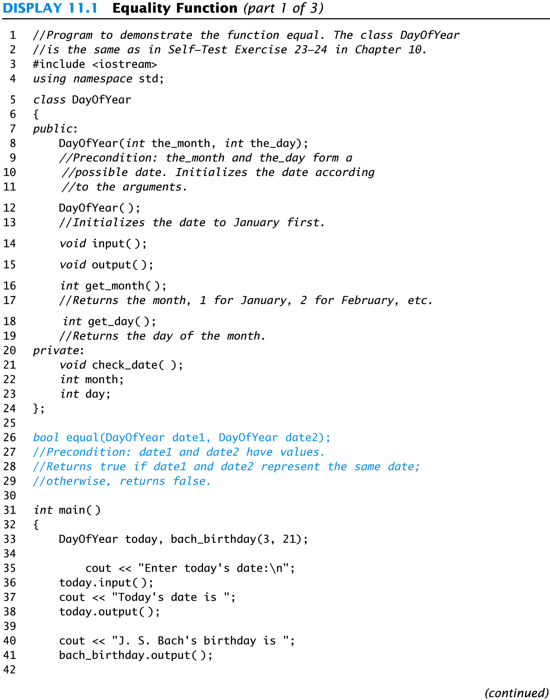
Display 11.1 (1/3)
Back
Next
Slide 11- <number>

Slide 99
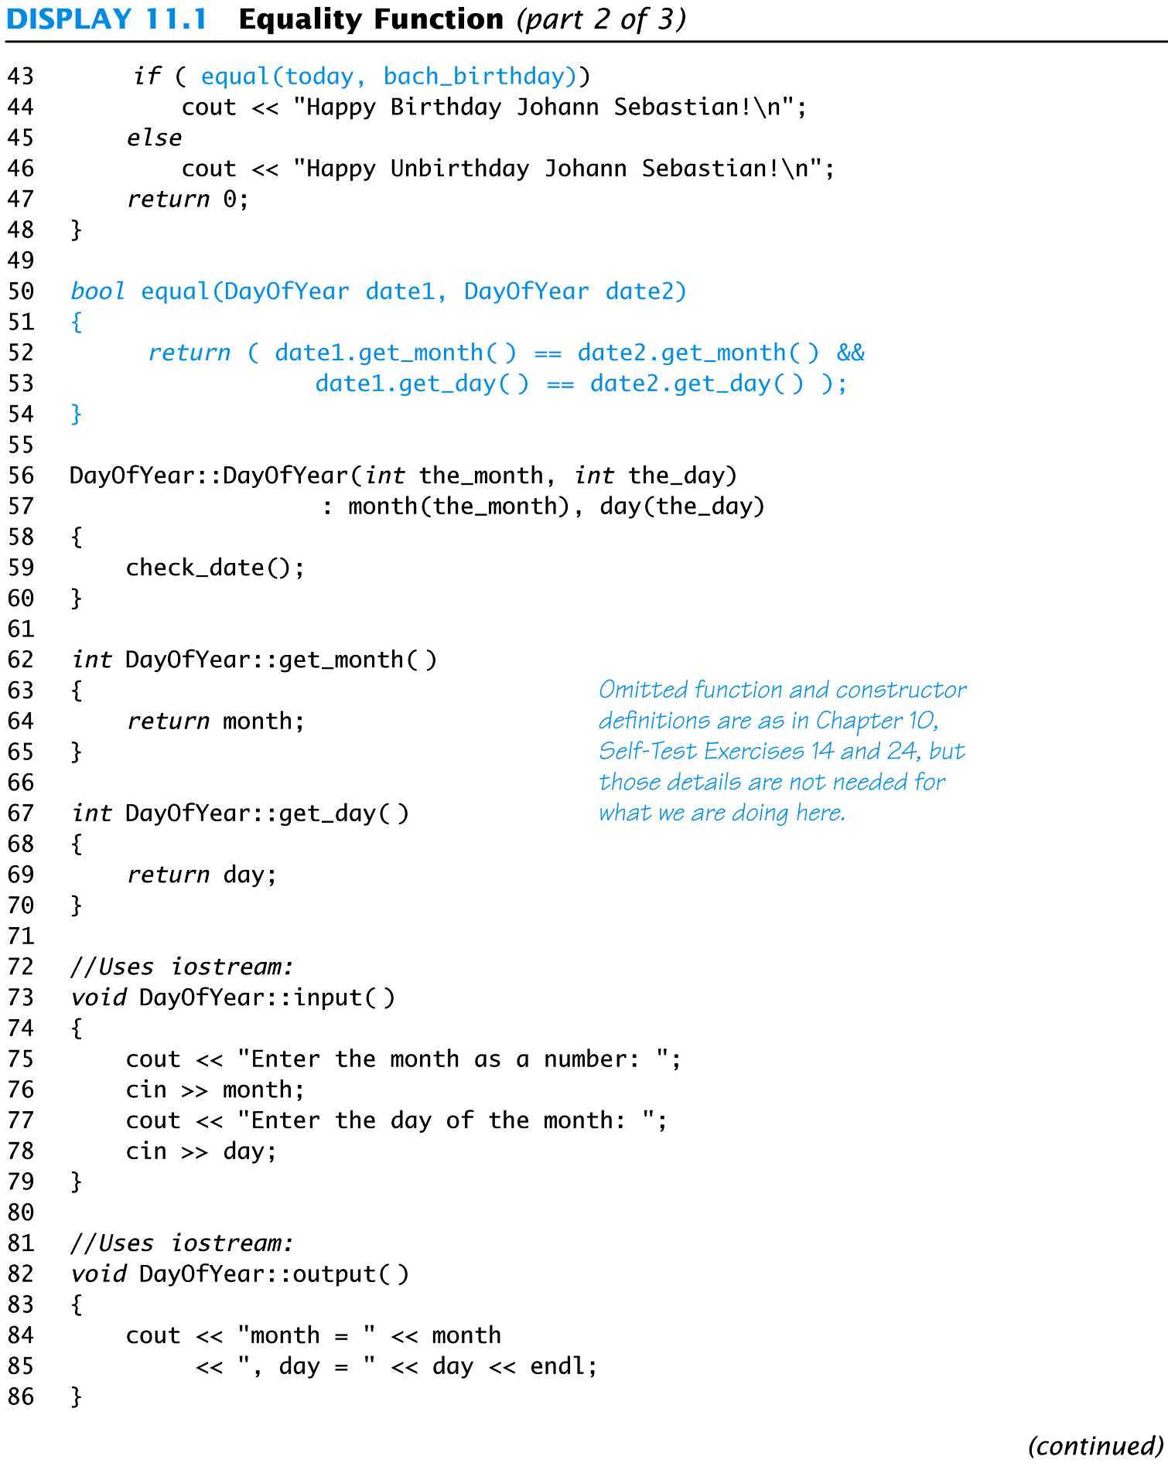
Display 11.1 (2/3)
Back
Next
Slide 11- <number>

Slide 100
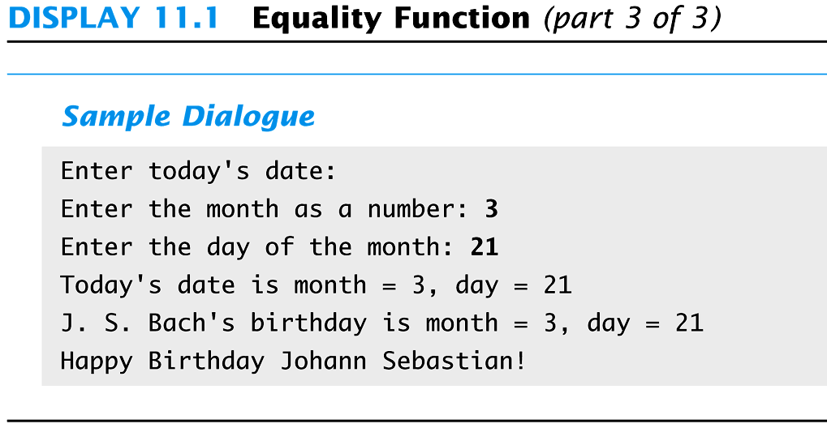
Display 11.1
(3/3)
Back
Next
Slide 11- <number>

Slide 101
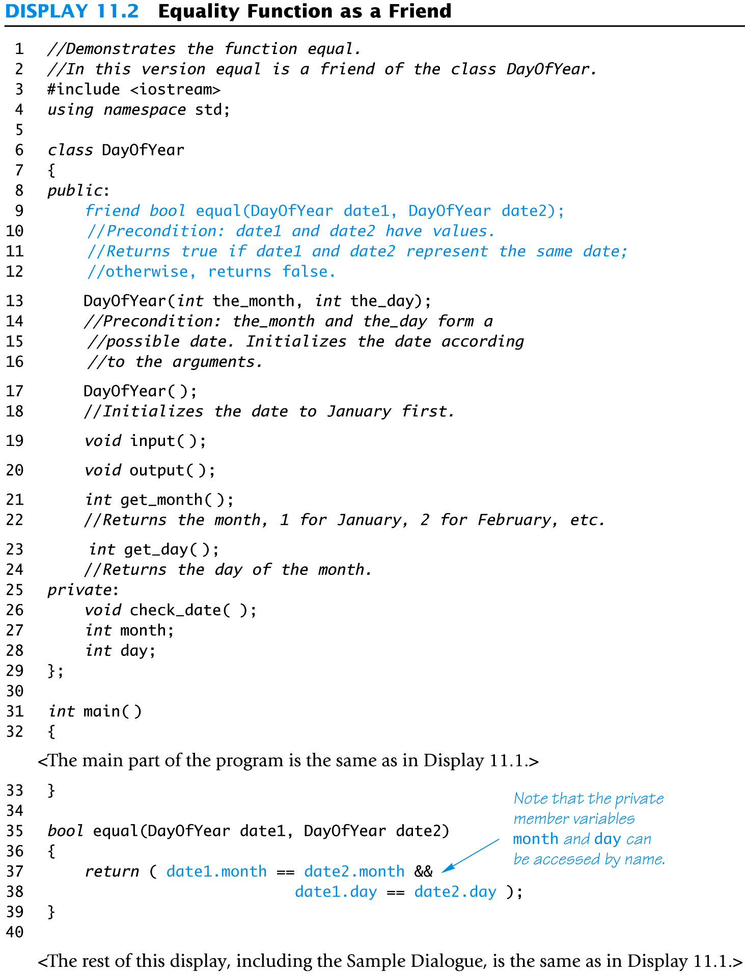
Display 11.2
Back
Next
Slide 11- <number>

Slide 102
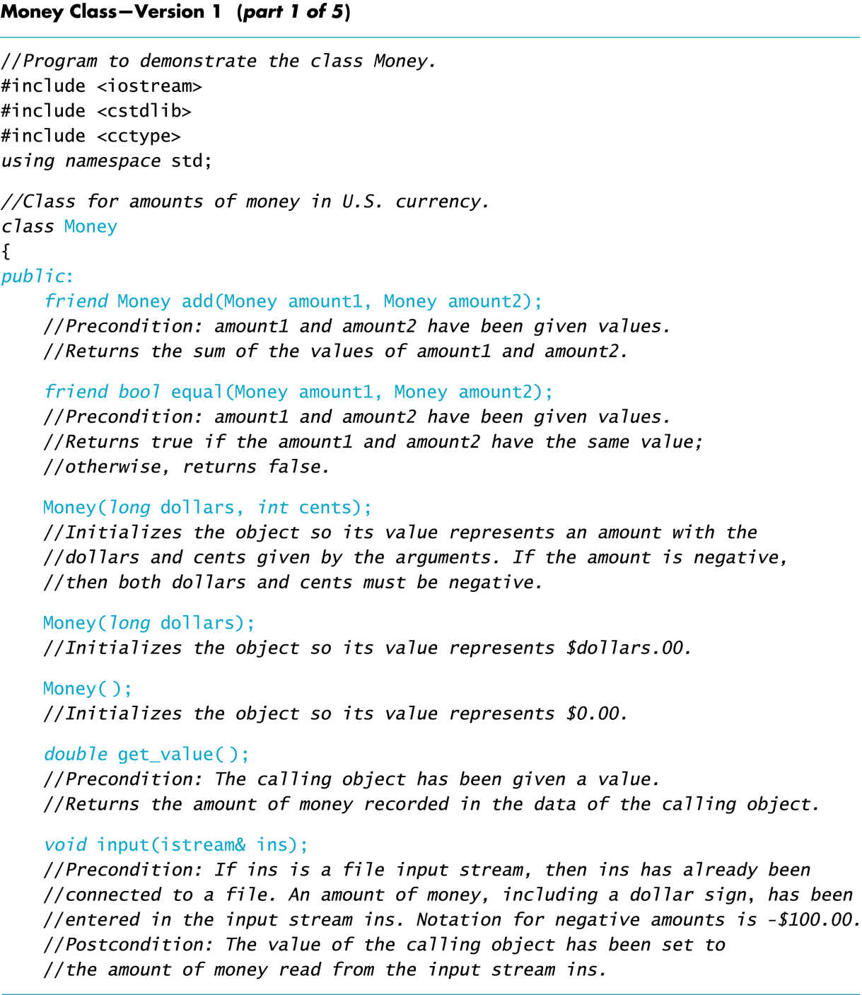
Display 11.3 (1/5)
Back
Next
Slide 11- <number>

Slide 103
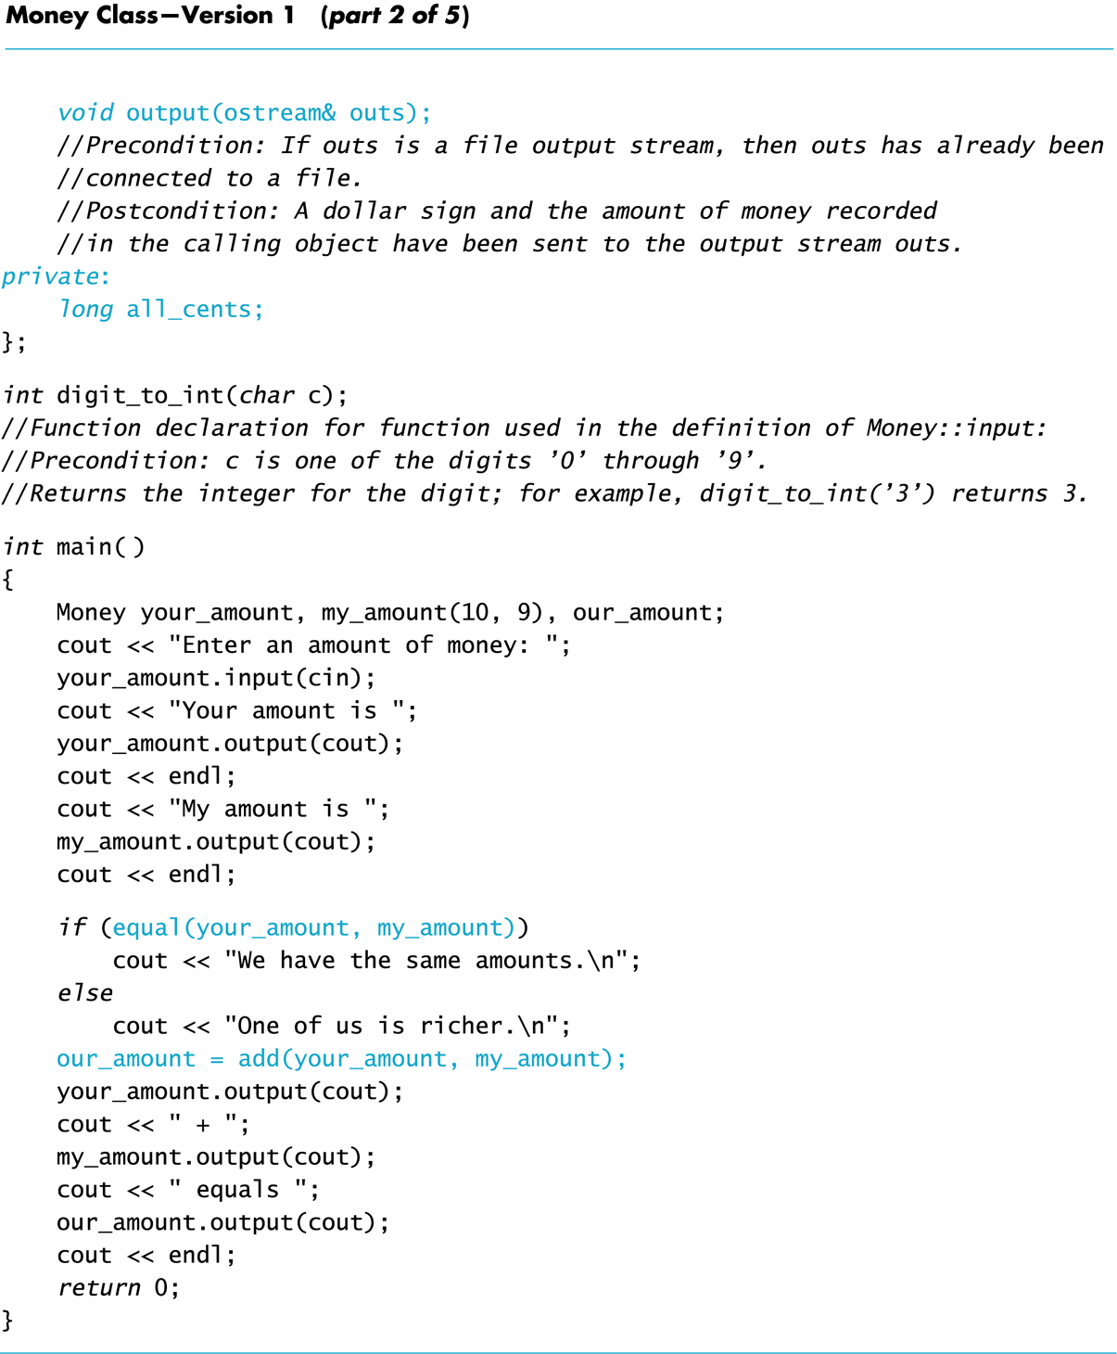
Display 11.3 (2/5)
Back
Next
Slide 11- <number>

Slide 104
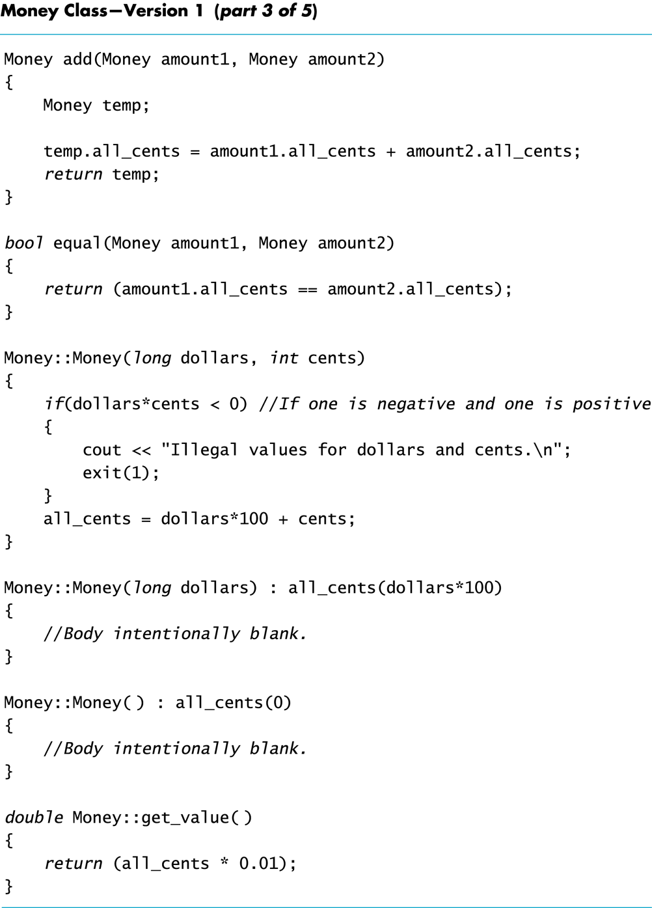
Display 11.3 (3/5)
Back
Next
Slide 11- <number>

Slide 105
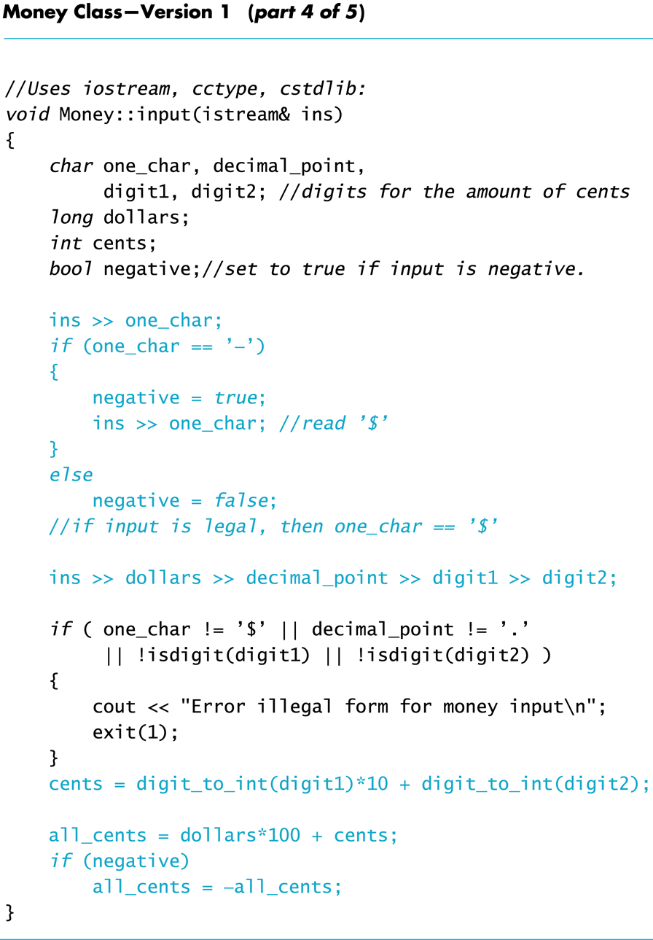
Display 11.3 (4/5)
Back
Next
Slide 11- <number>

Slide 106
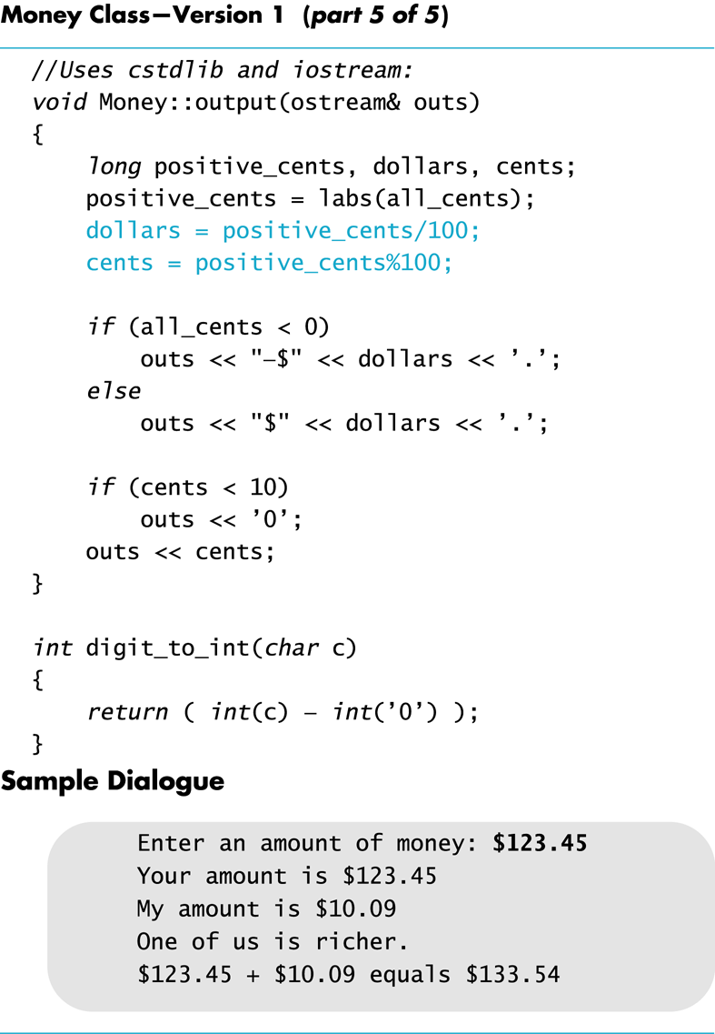
Display 11.3 (5/5)
Back
Next
Slide 11- <number>

Slide 107
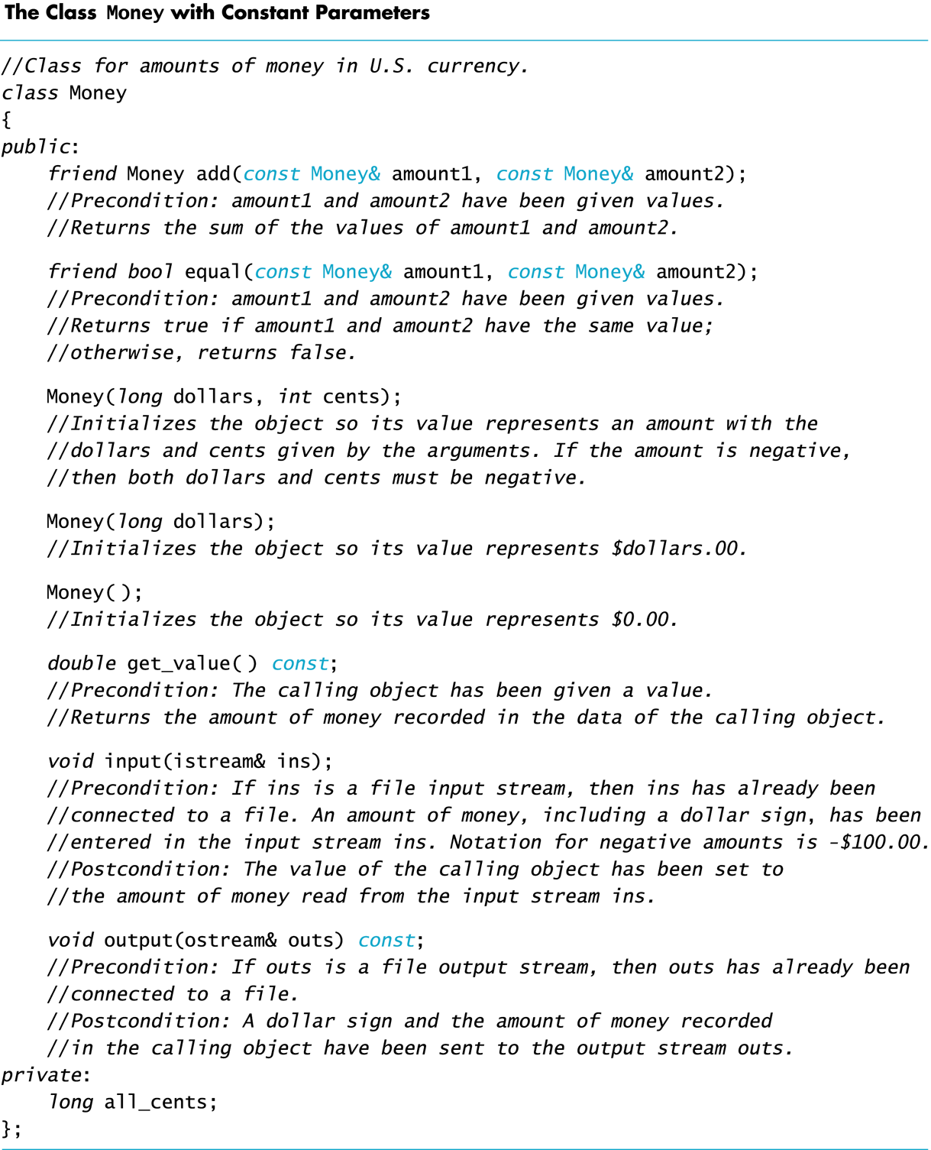
Display 11.4
Back
Next
Slide 11- <number>

Slide 108
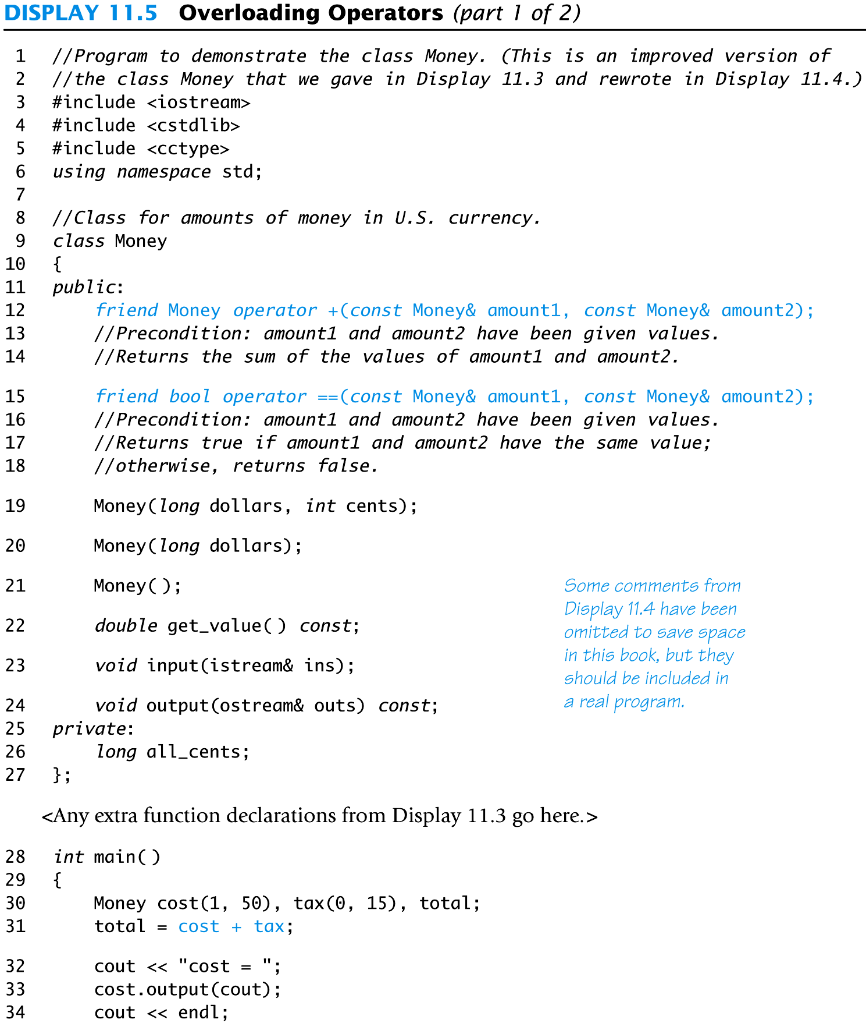
Display 11.5 (1/2)
Back
Next
Slide 11- <number>

Slide 109
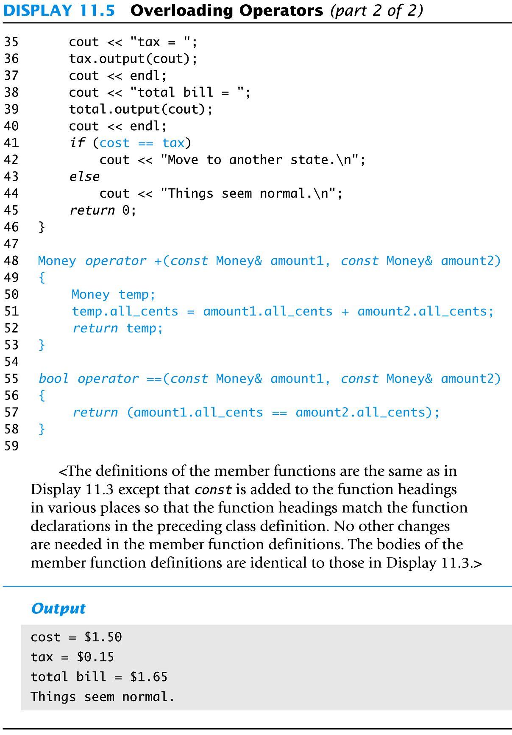
Display 11.5 (2/2)
Back
Next
Slide 11- <number>

Slide 110
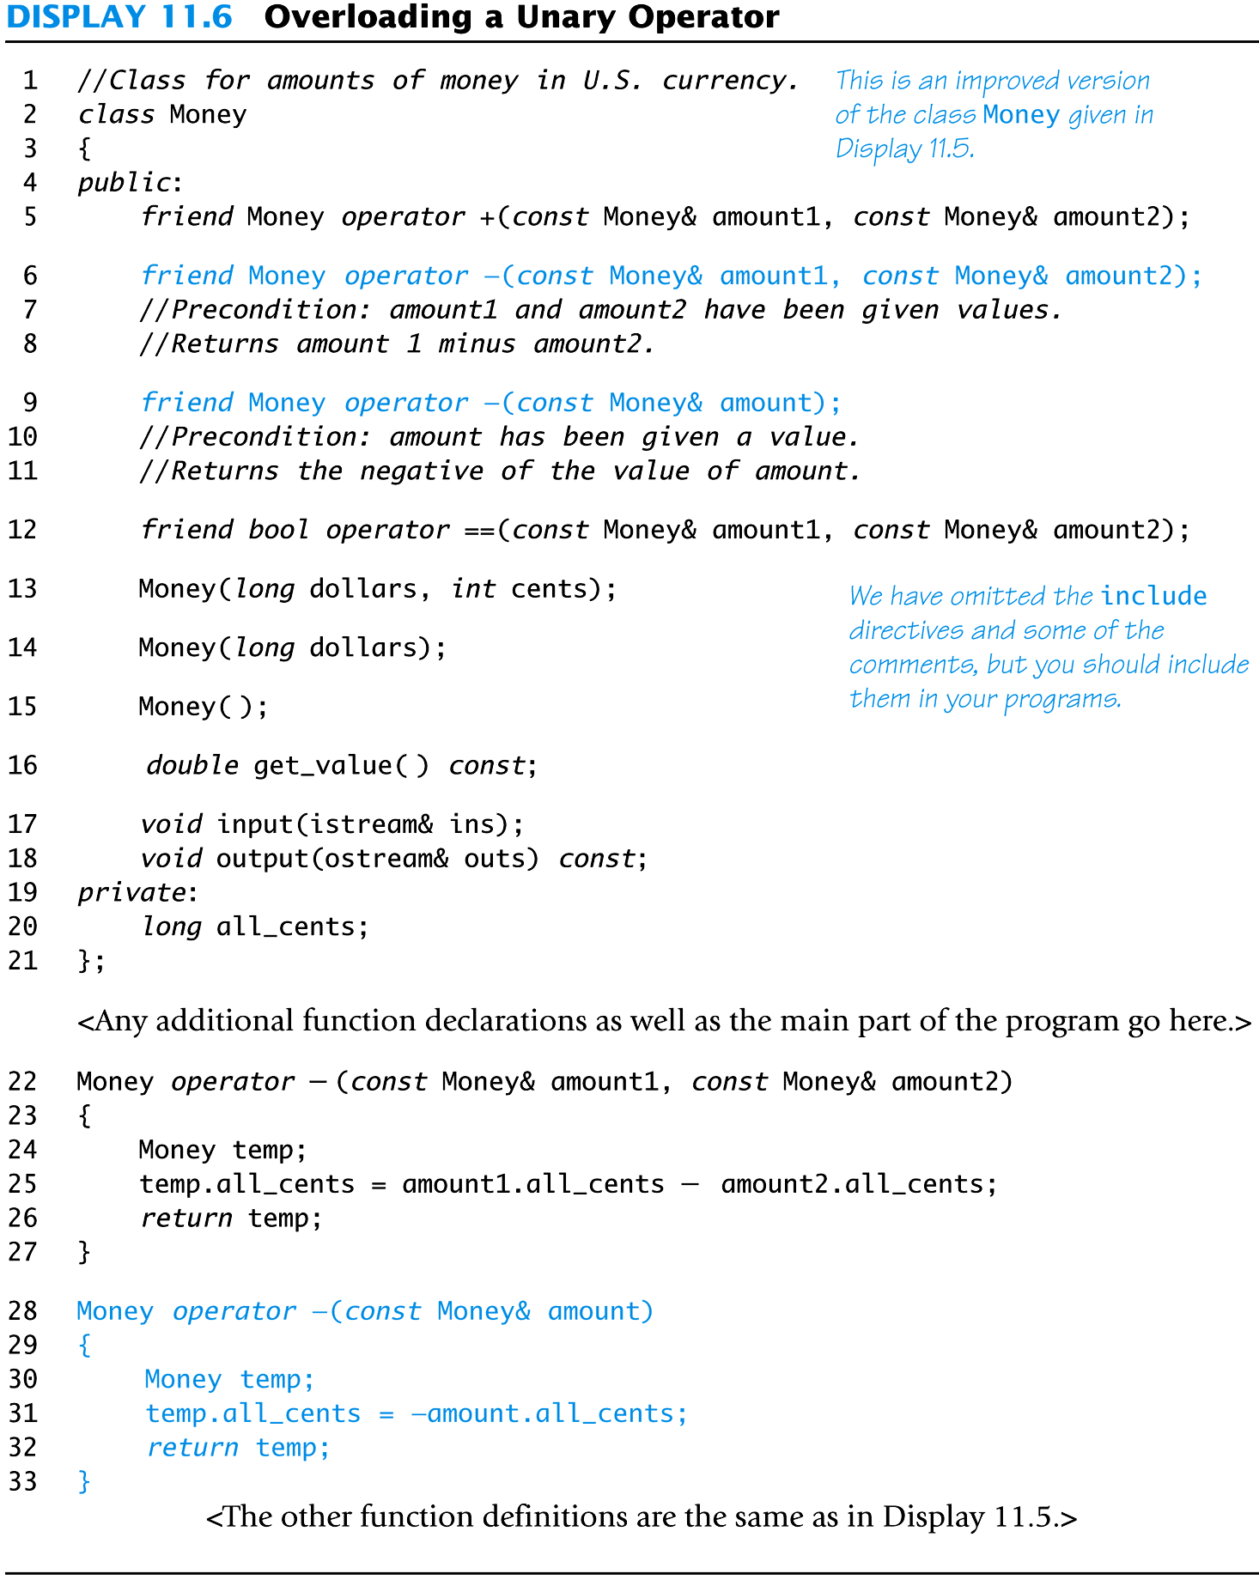
Display 11.6
Back
Next
Slide 11- <number>

Slide 111
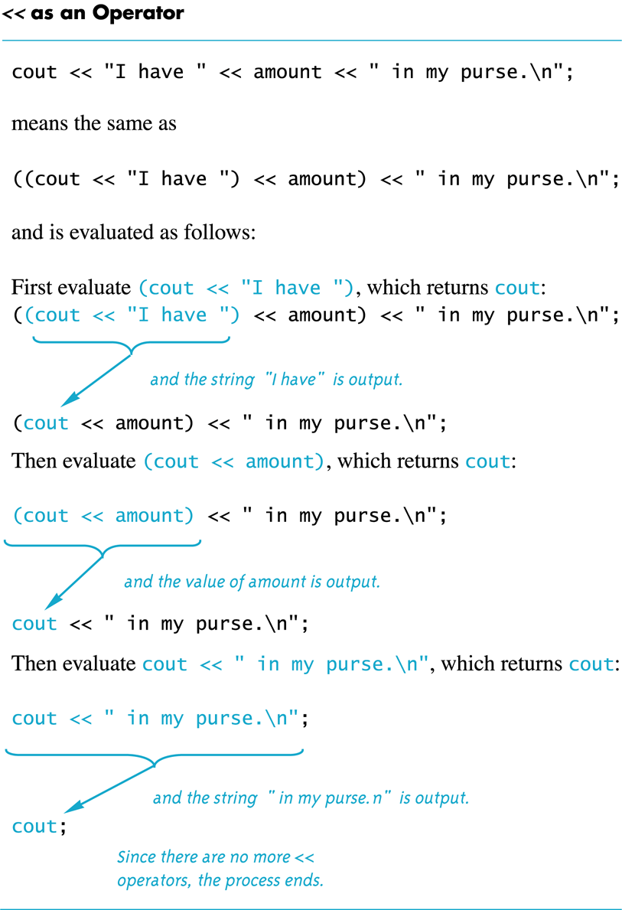
Display 11.7
Back
Next
Slide 11- <number>

Slide 112
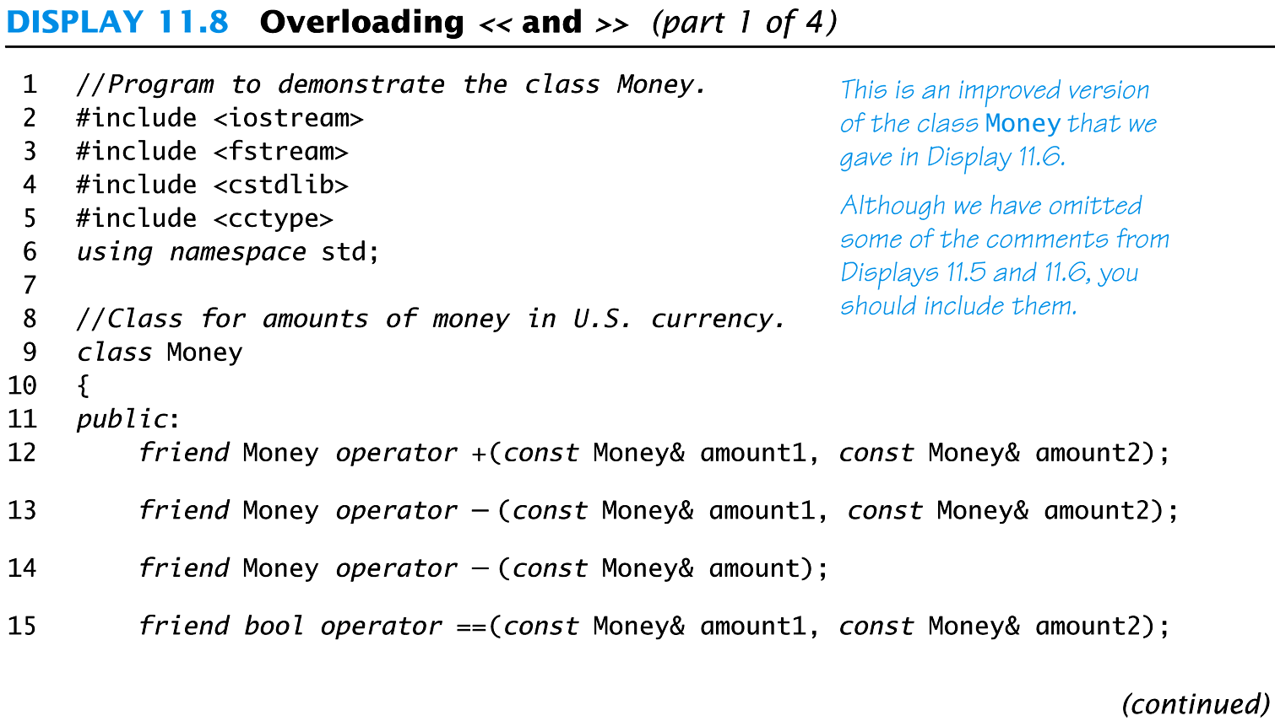
Display 11.8
(1/4)
Back
Next
Slide 11- <number>

Slide 113
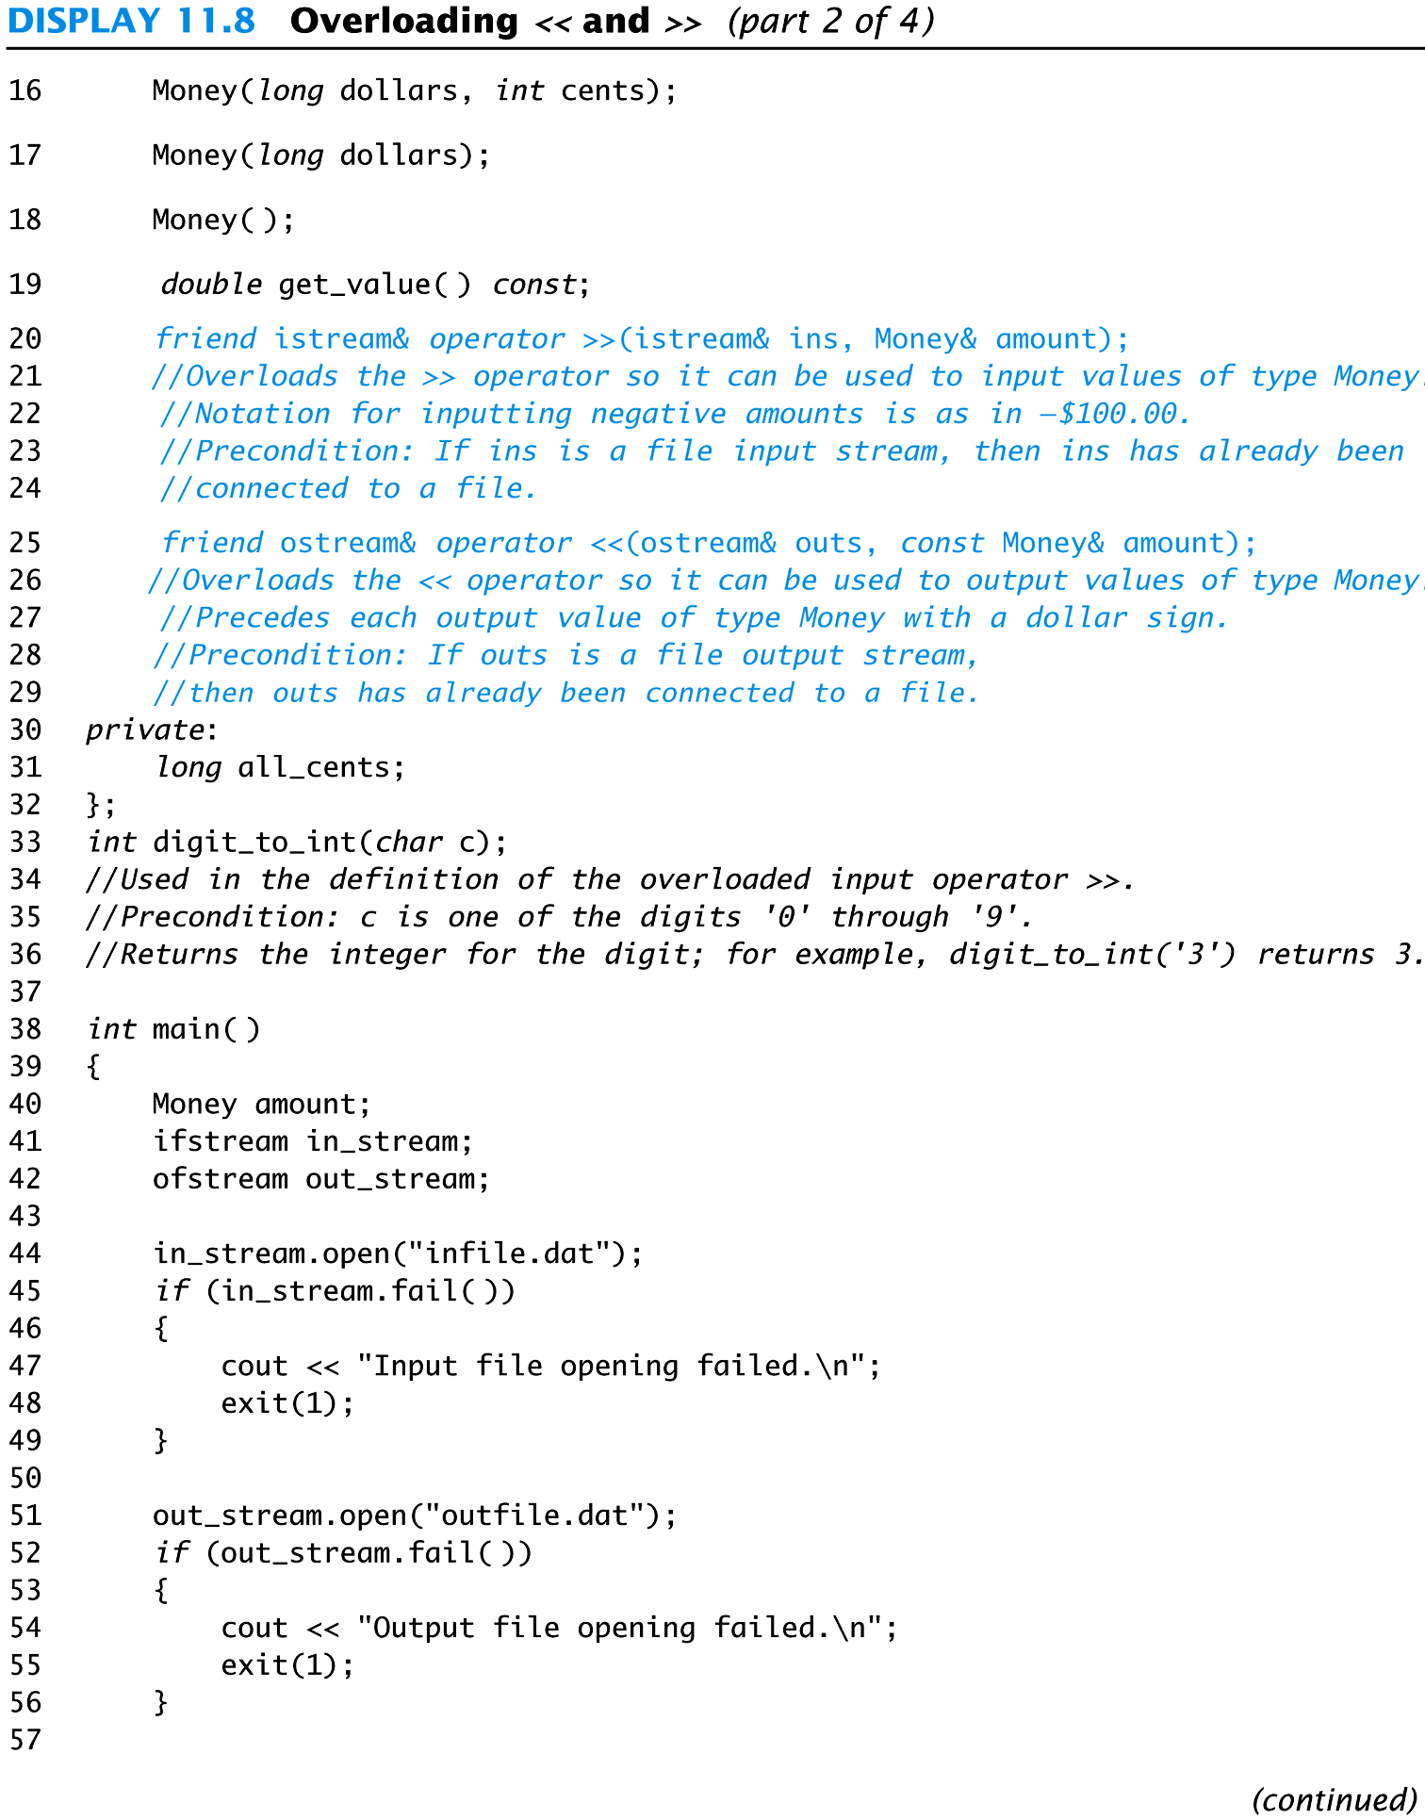
Display 11.8(2/4)
Back
Next
Slide 11- <number>

Slide 114
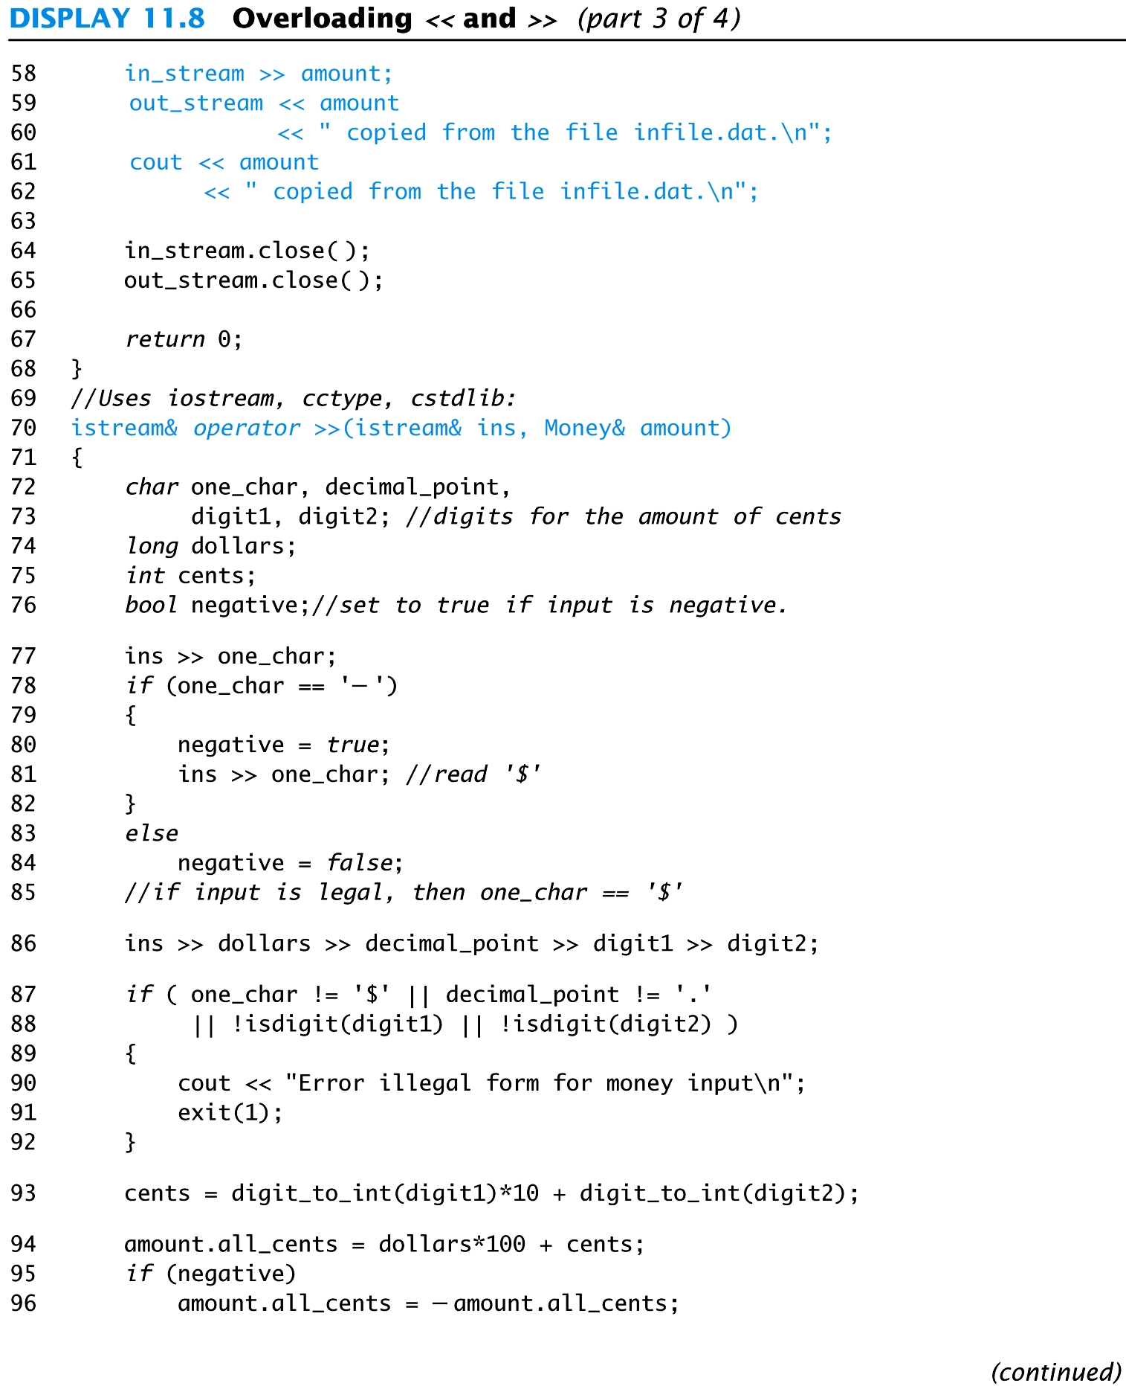
Display 11.8 (3/4)
Back
Next
Slide 11- <number>

Slide 115
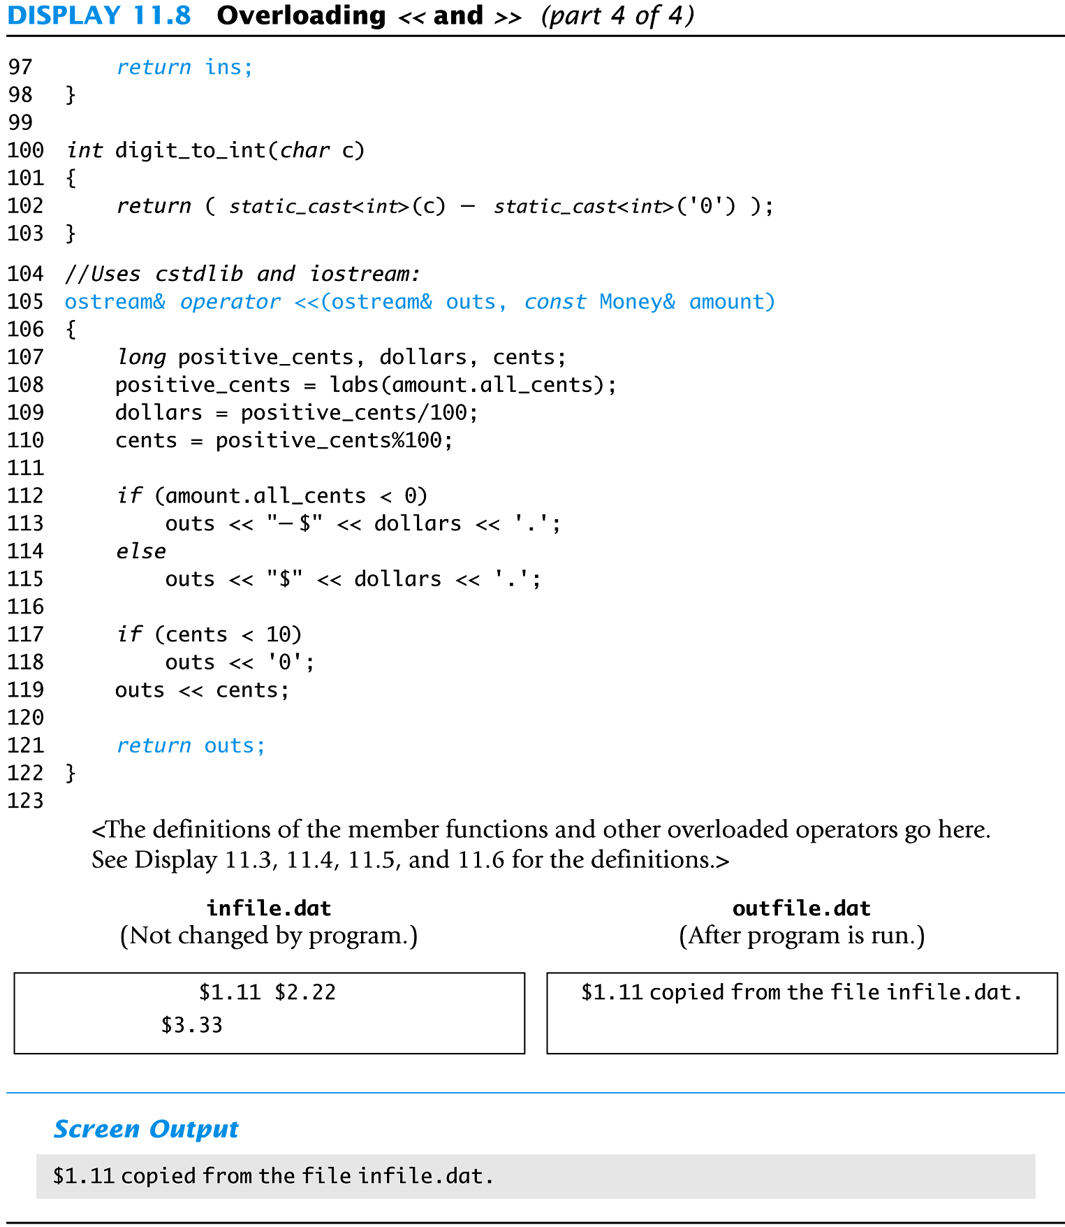
Display 11.8 (4/4)
Back
Next
Slide 11- <number>

Slide 116
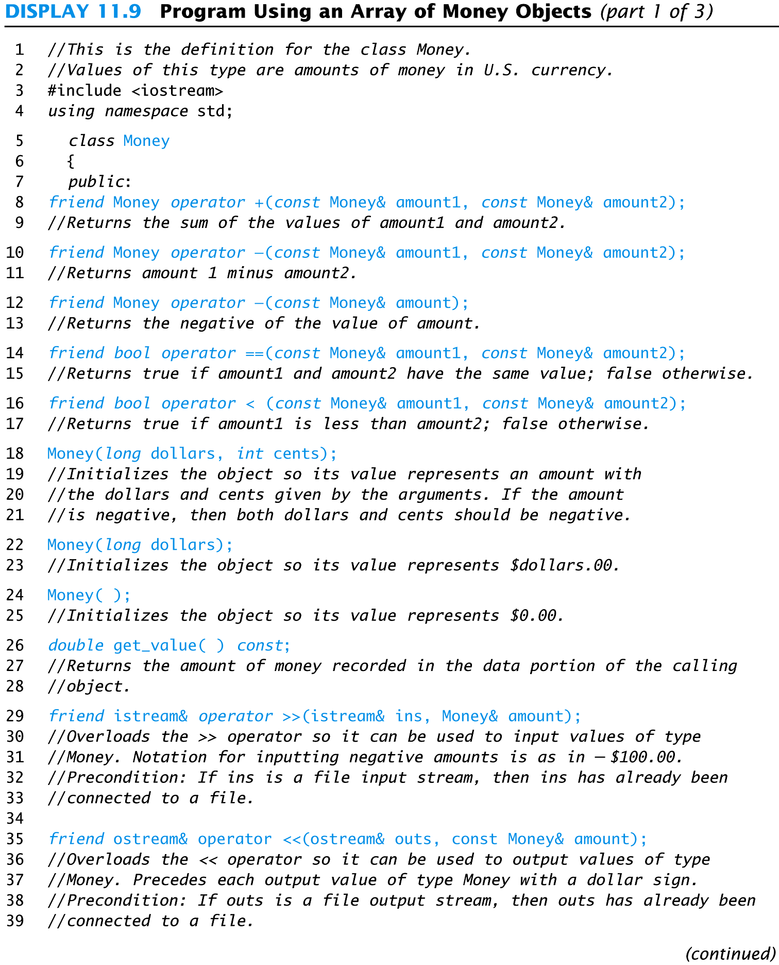
Display 11.9 (1/3)
Back
Next
Slide 11- <number>

Slide 117
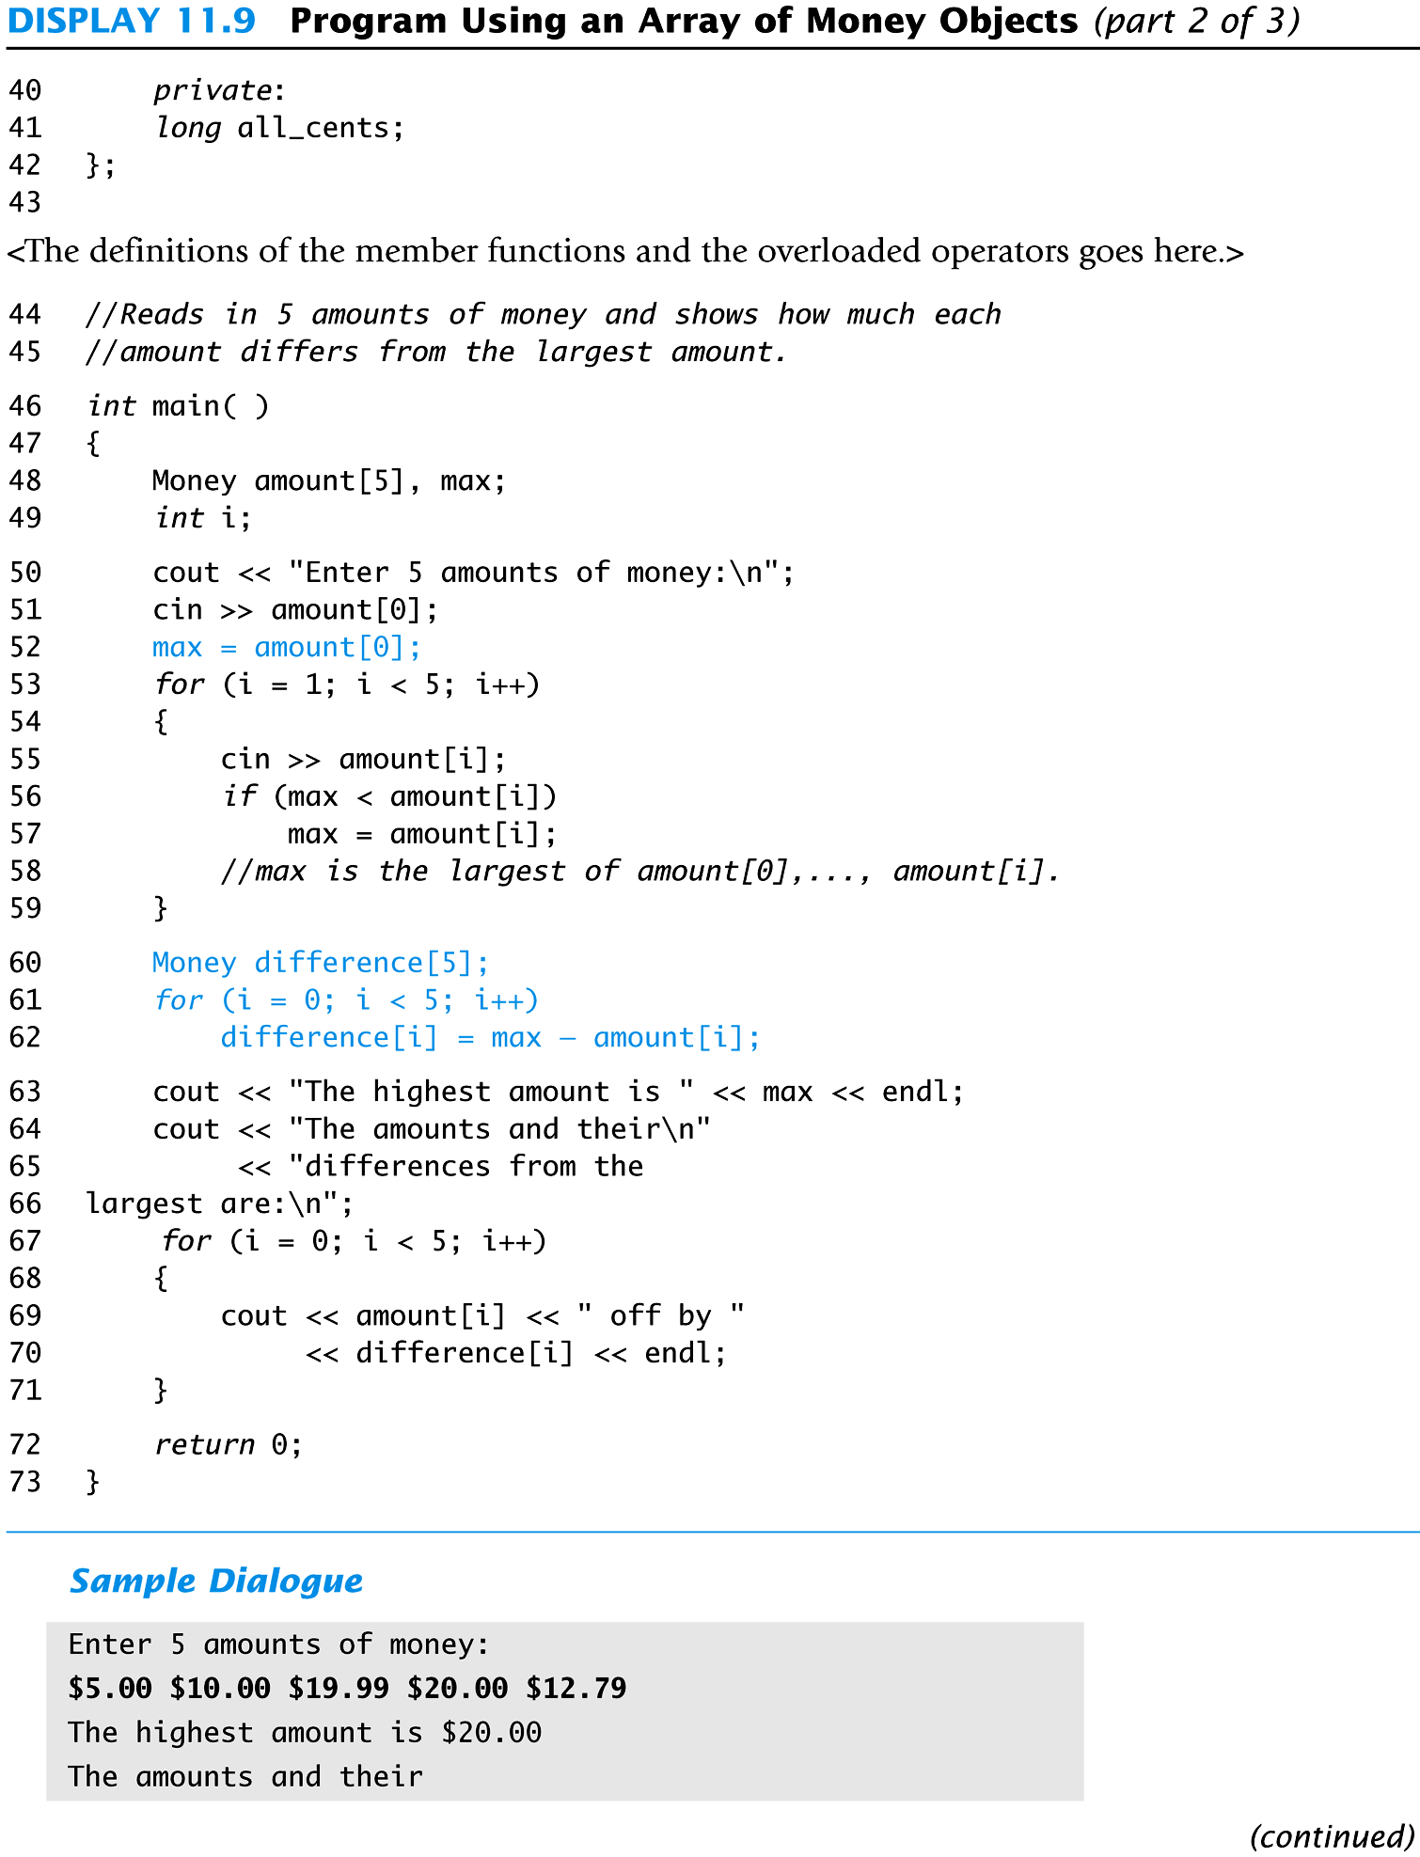
Display 11.9 (2/3)
Back
Next
Slide 11- <number>

Slide 118
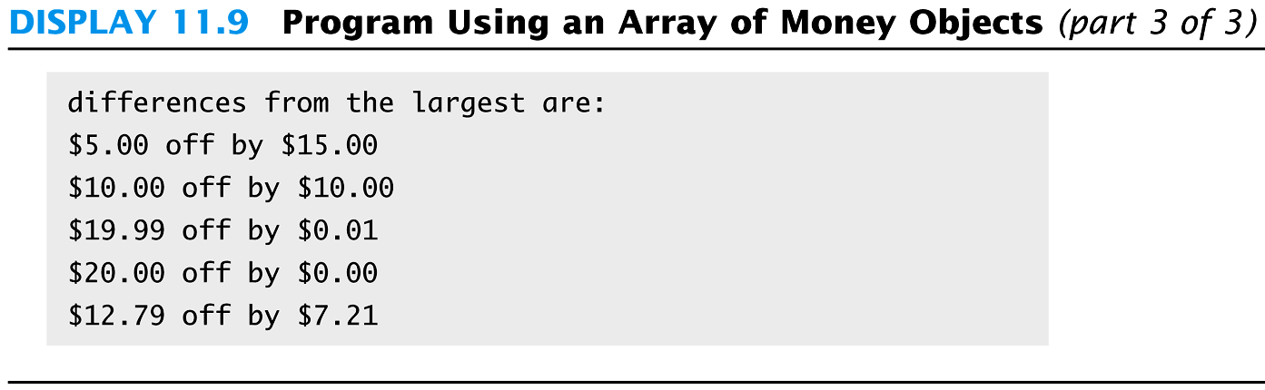
Display 11.9
(3/3)
Back
Next
Slide 11- <number>

Slide 119
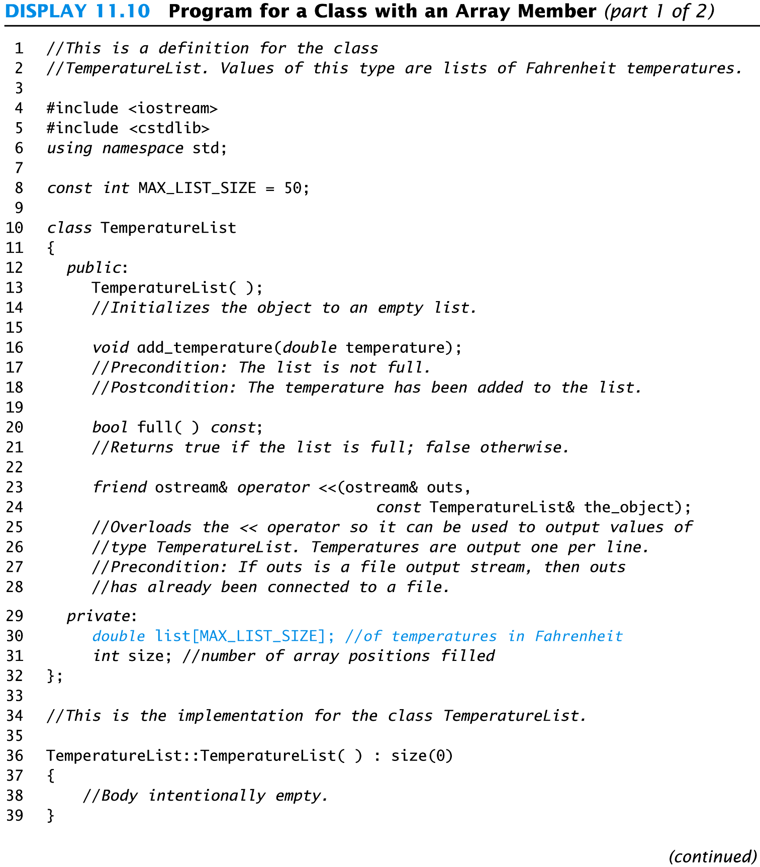
Display 11.10 (1/2)
Back
Next
Slide 11- <number>

Slide 120
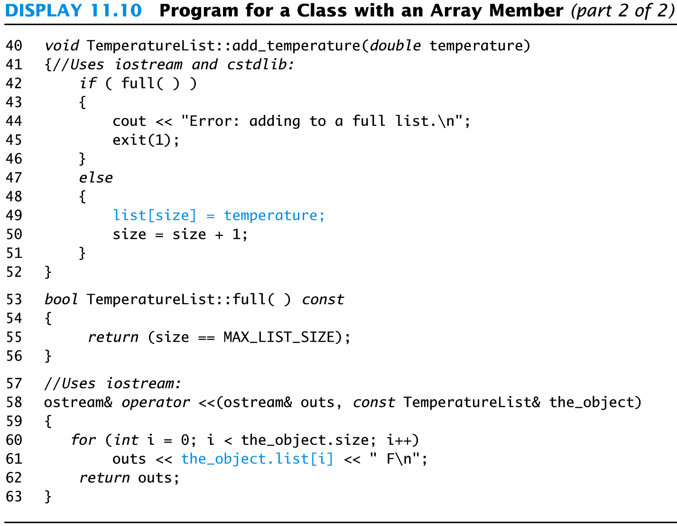
Display 11.10
(2/2)
Back
Next
Slide 11- <number>

Slide 121
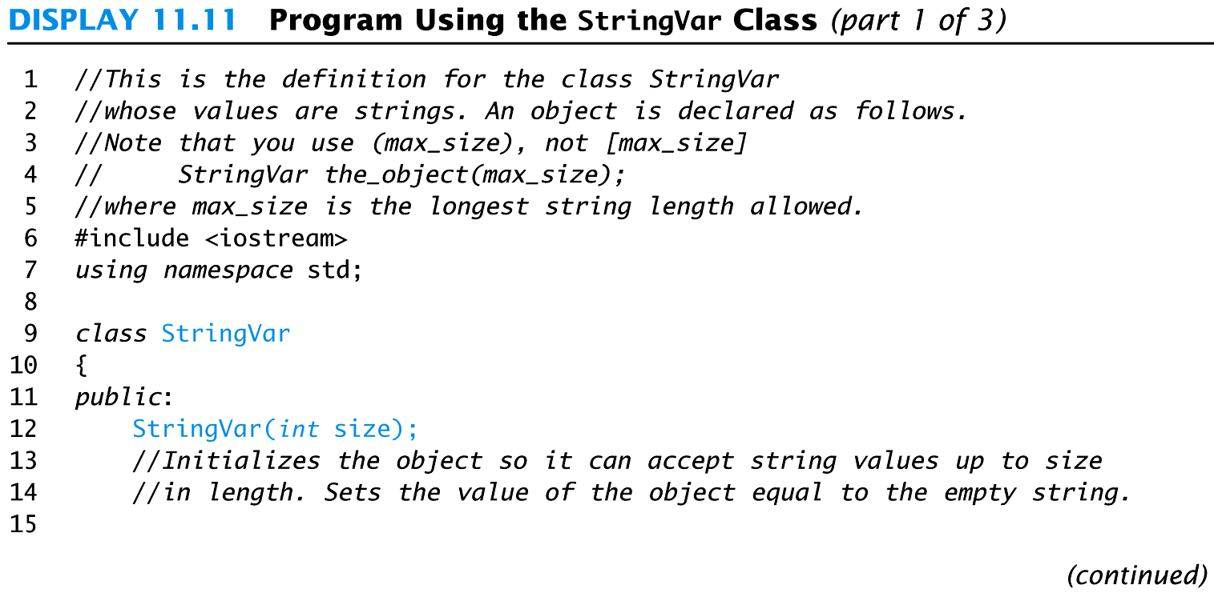
Display 11.11
(1/3)
Back
Next
Slide 11- <number>

Slide 122
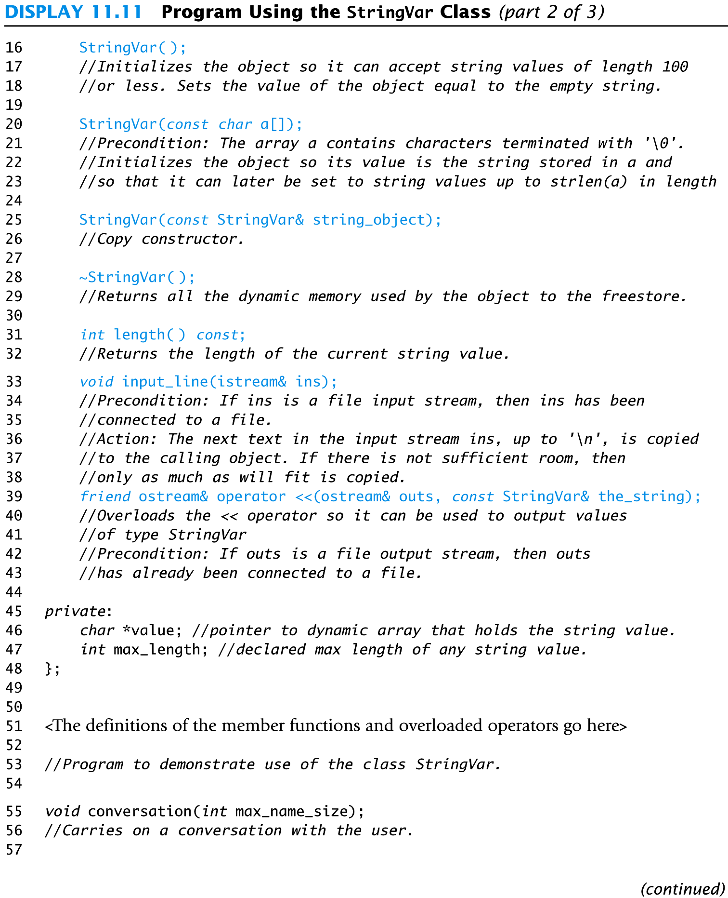
Display 11.11 (2/3)
Back
Next
Slide 11- <number>

Slide 123
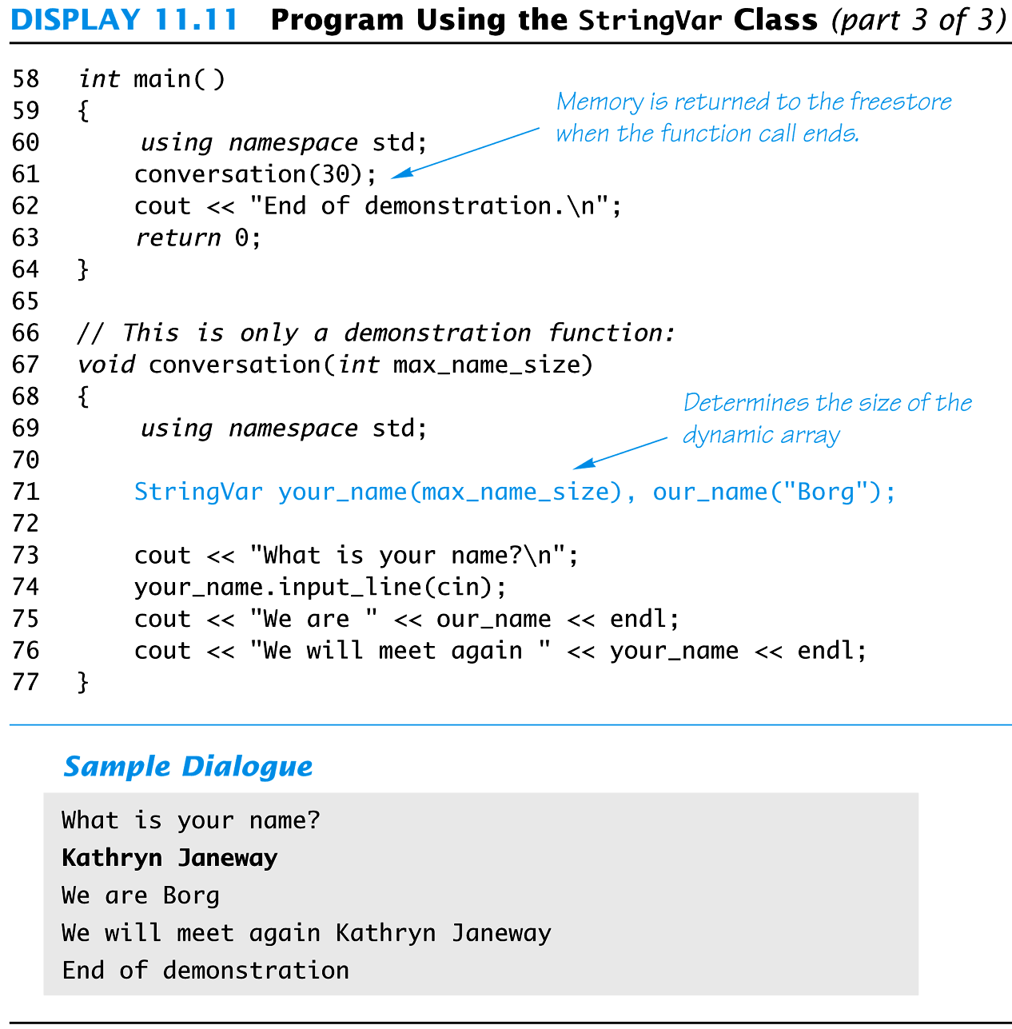
Display 11.11
(3/3)
Back
Next
Slide 11- <number>

Slide 124
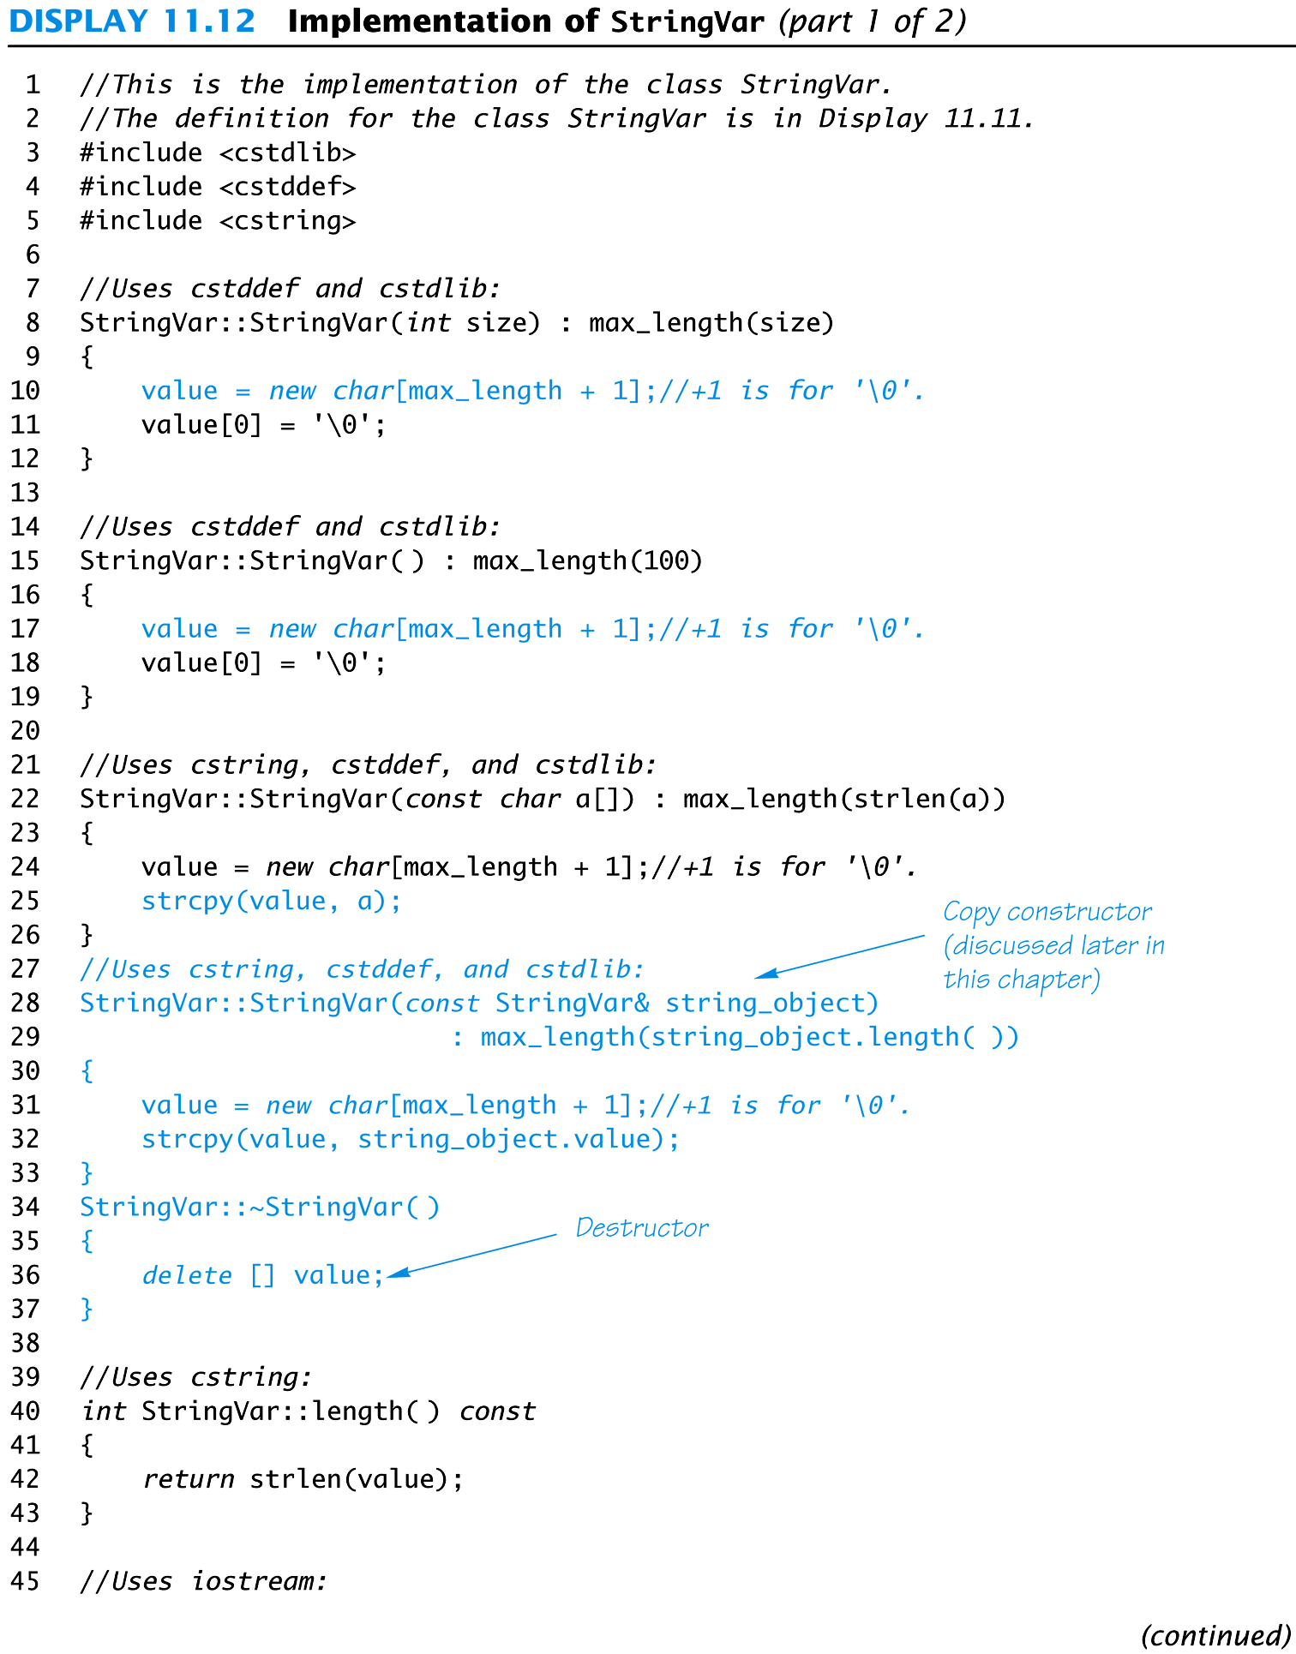
Display 11.12 (1/2)
Back
Next
Slide 11- <number>

Slide 125
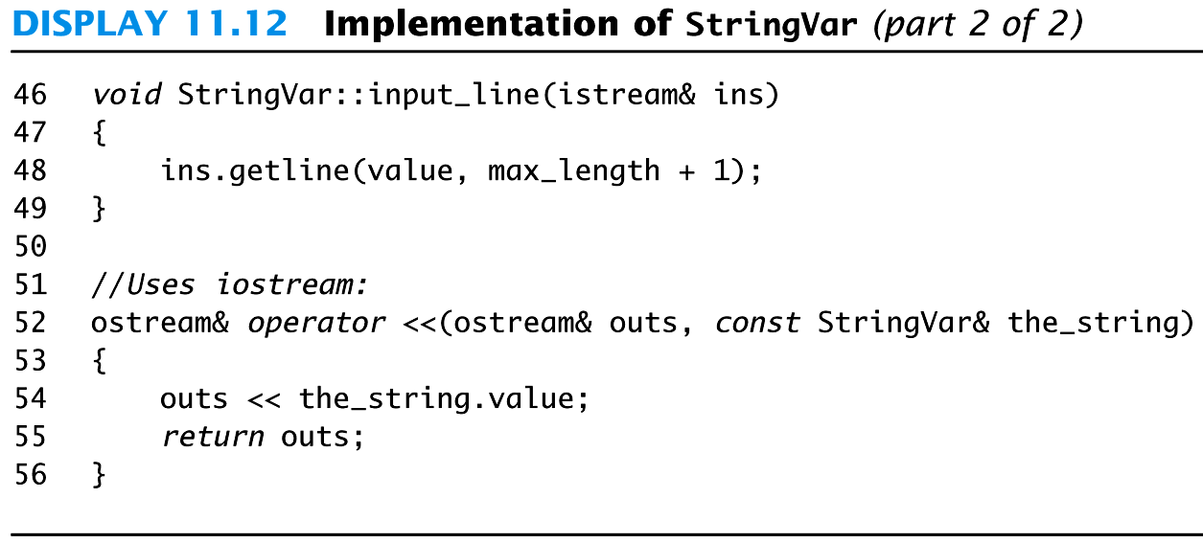
Display 11.12
(2/2)
Back
Next
Slide 11- <number>

Slide 126
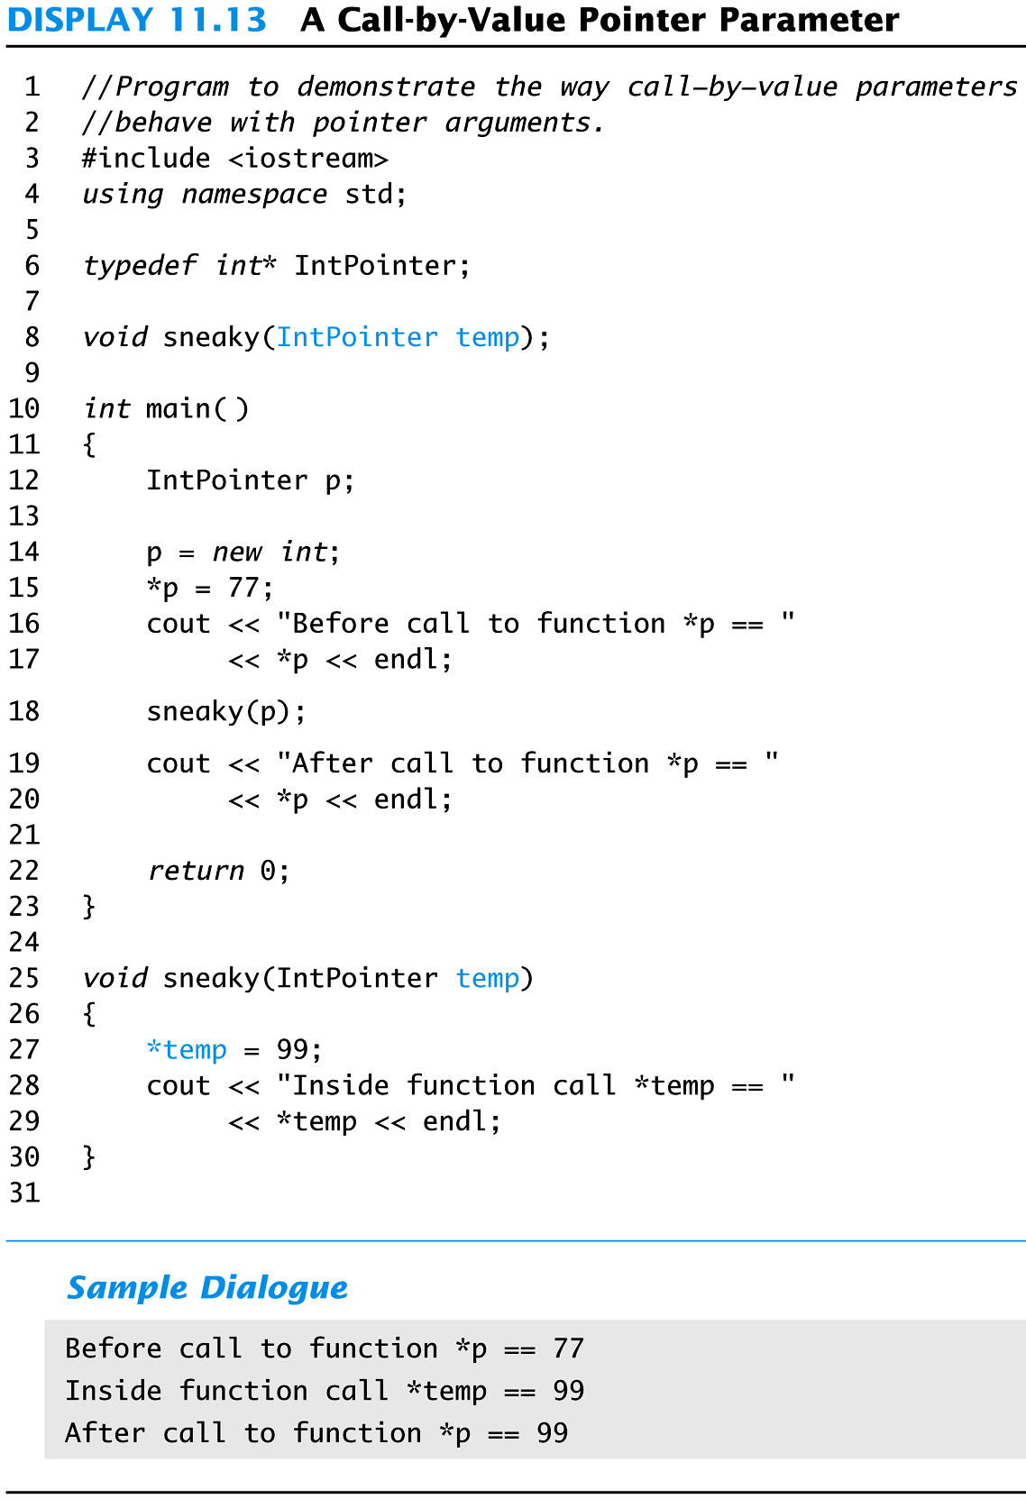
Display 11.13
Back
Next
Slide 11- <number>

Slide 127
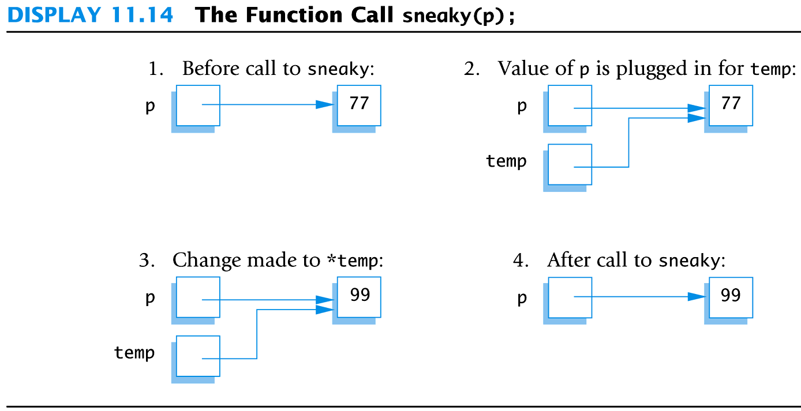
Display 11.14
Back
Next
Slide 11- <number>

